Slide 1


scTalk 3: How to Compute Trajectories and Pseudotime
Arash Bagherabadi
Feb18, 2026

Slide 3
Single Cell 101 ?

Slide 4
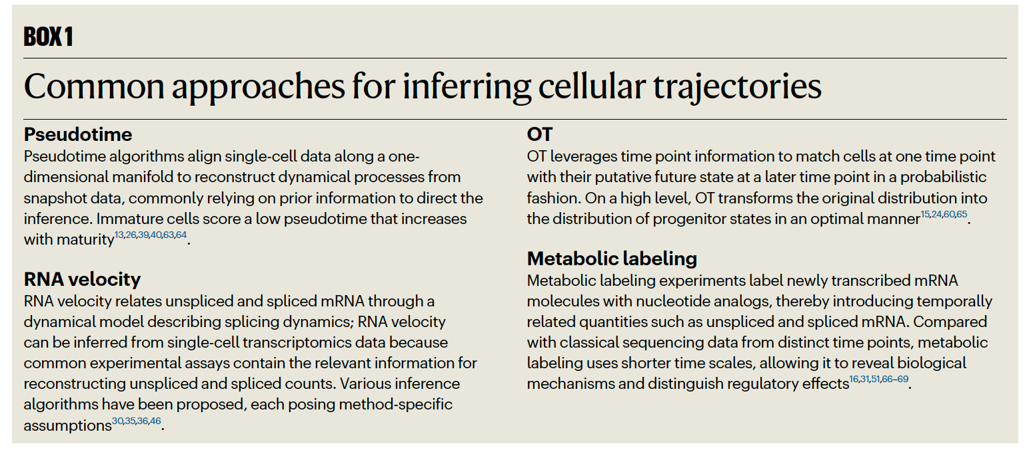

Slide 5
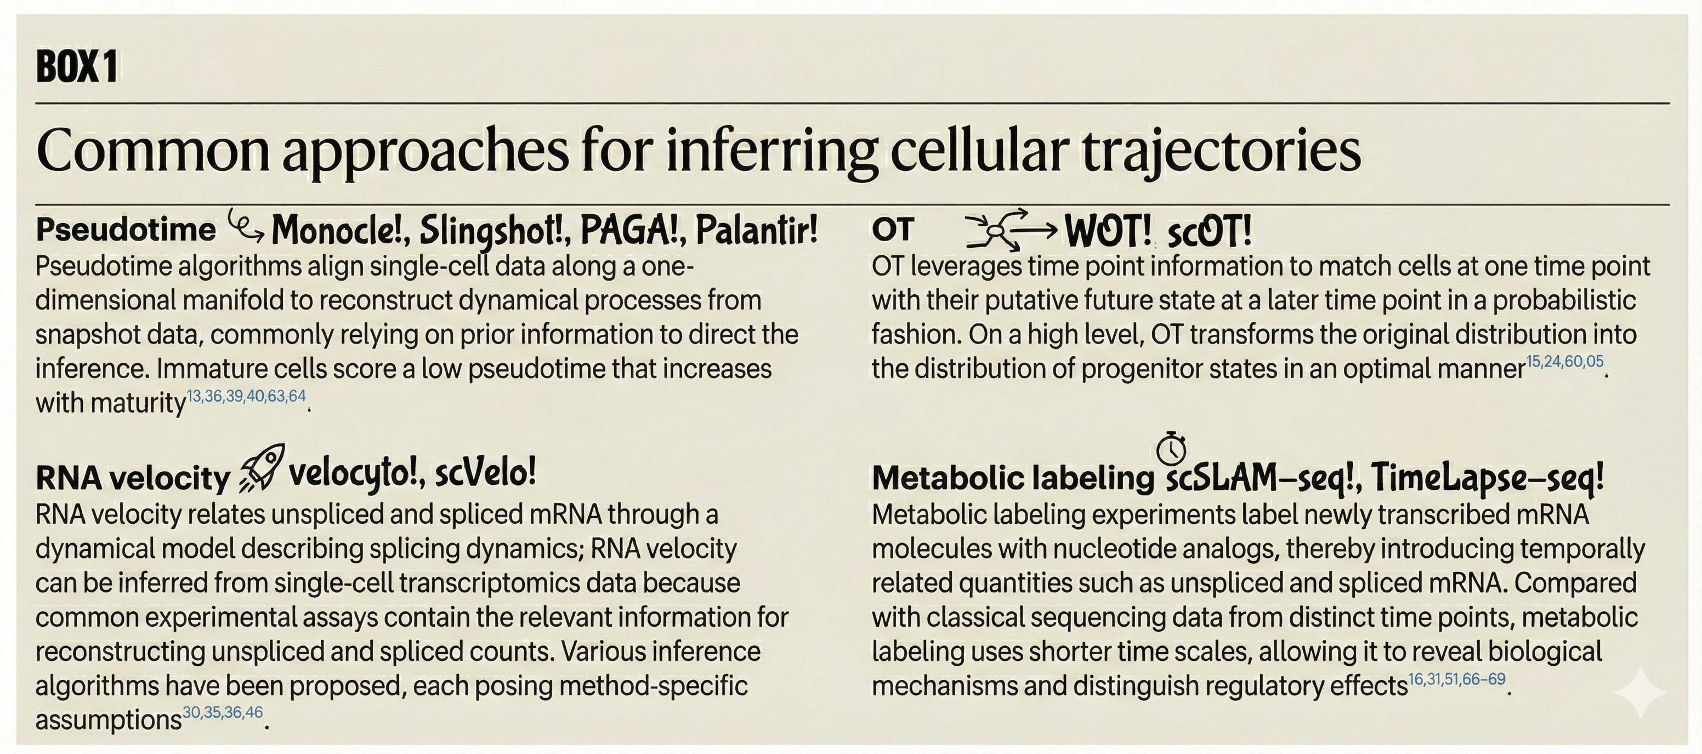

Slide 6
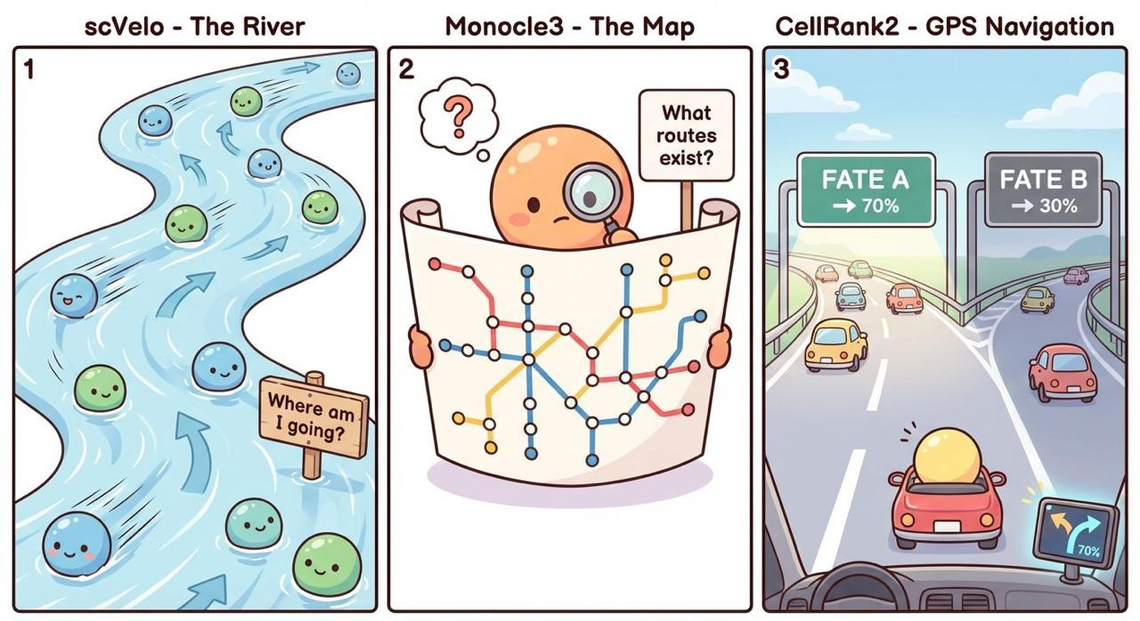
where cells are heading
+ how likely they are to end up there
Xinru Qiu, LinkedIn

Slide 7
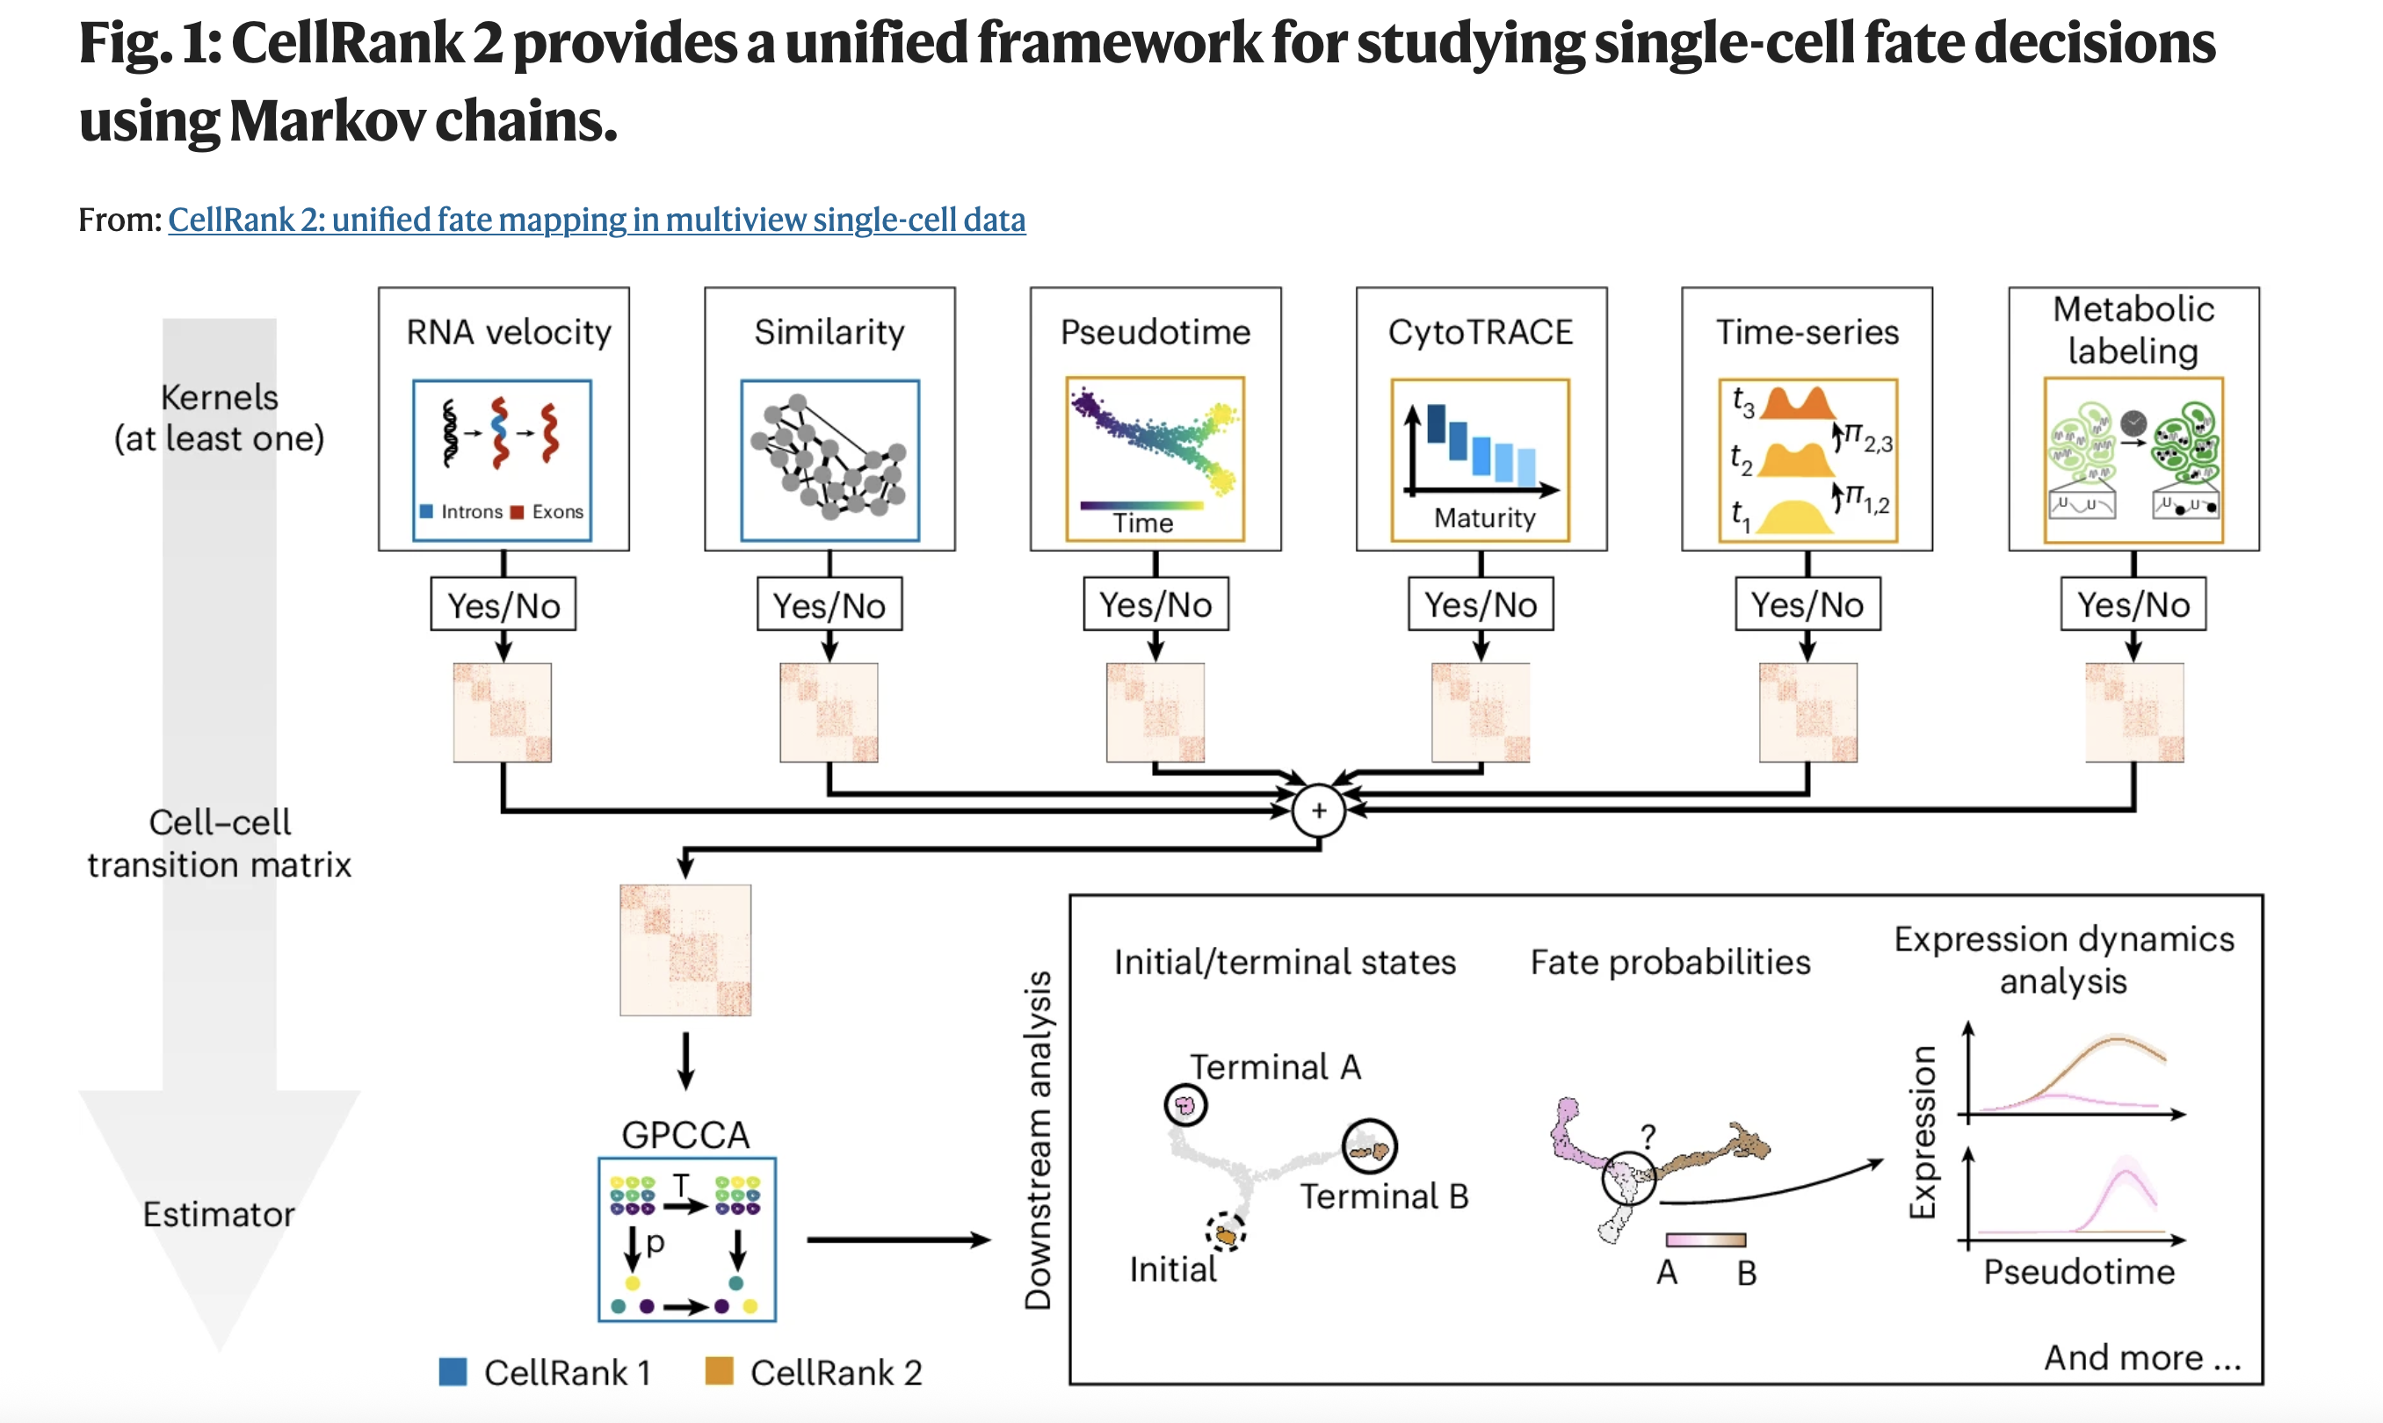
(OT)

Slide 8


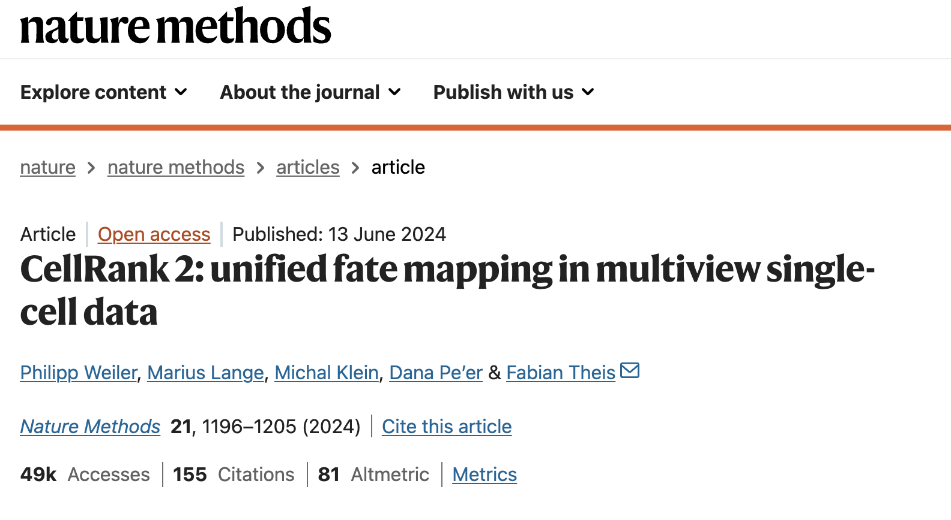
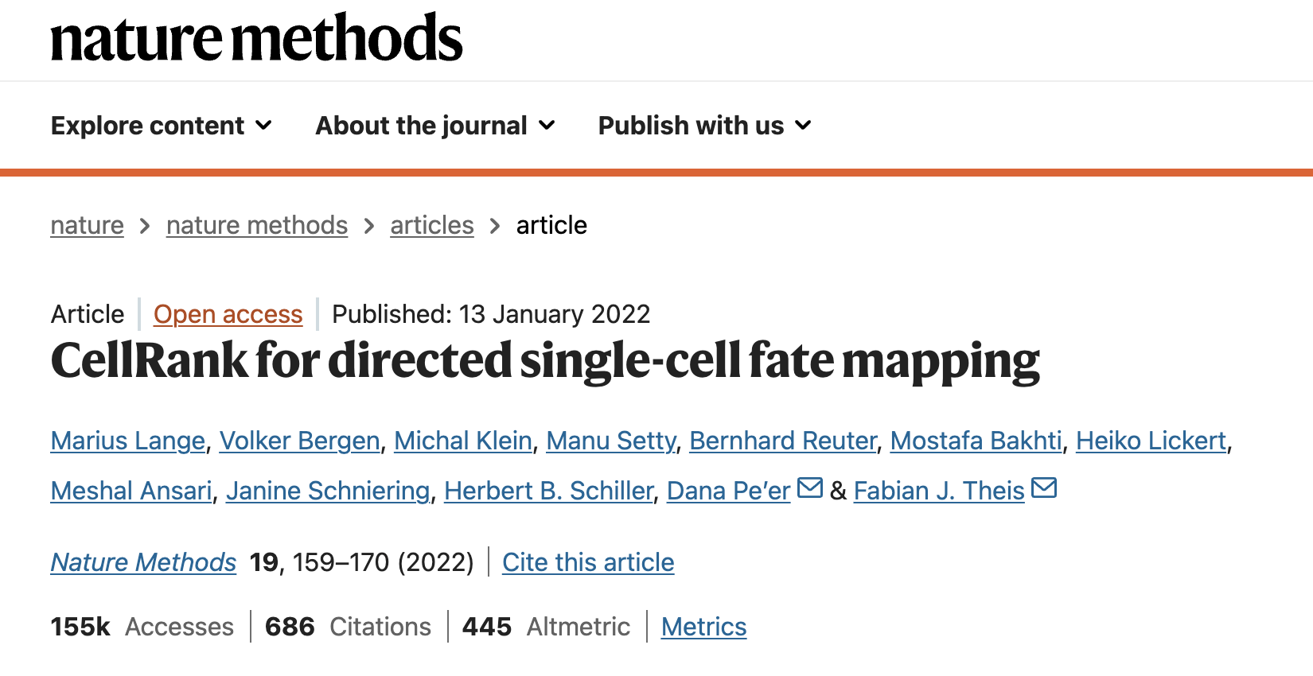
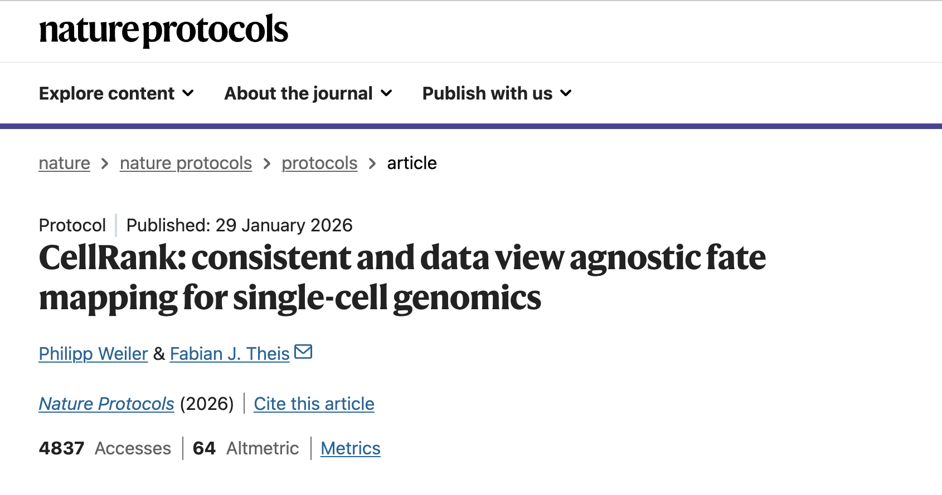
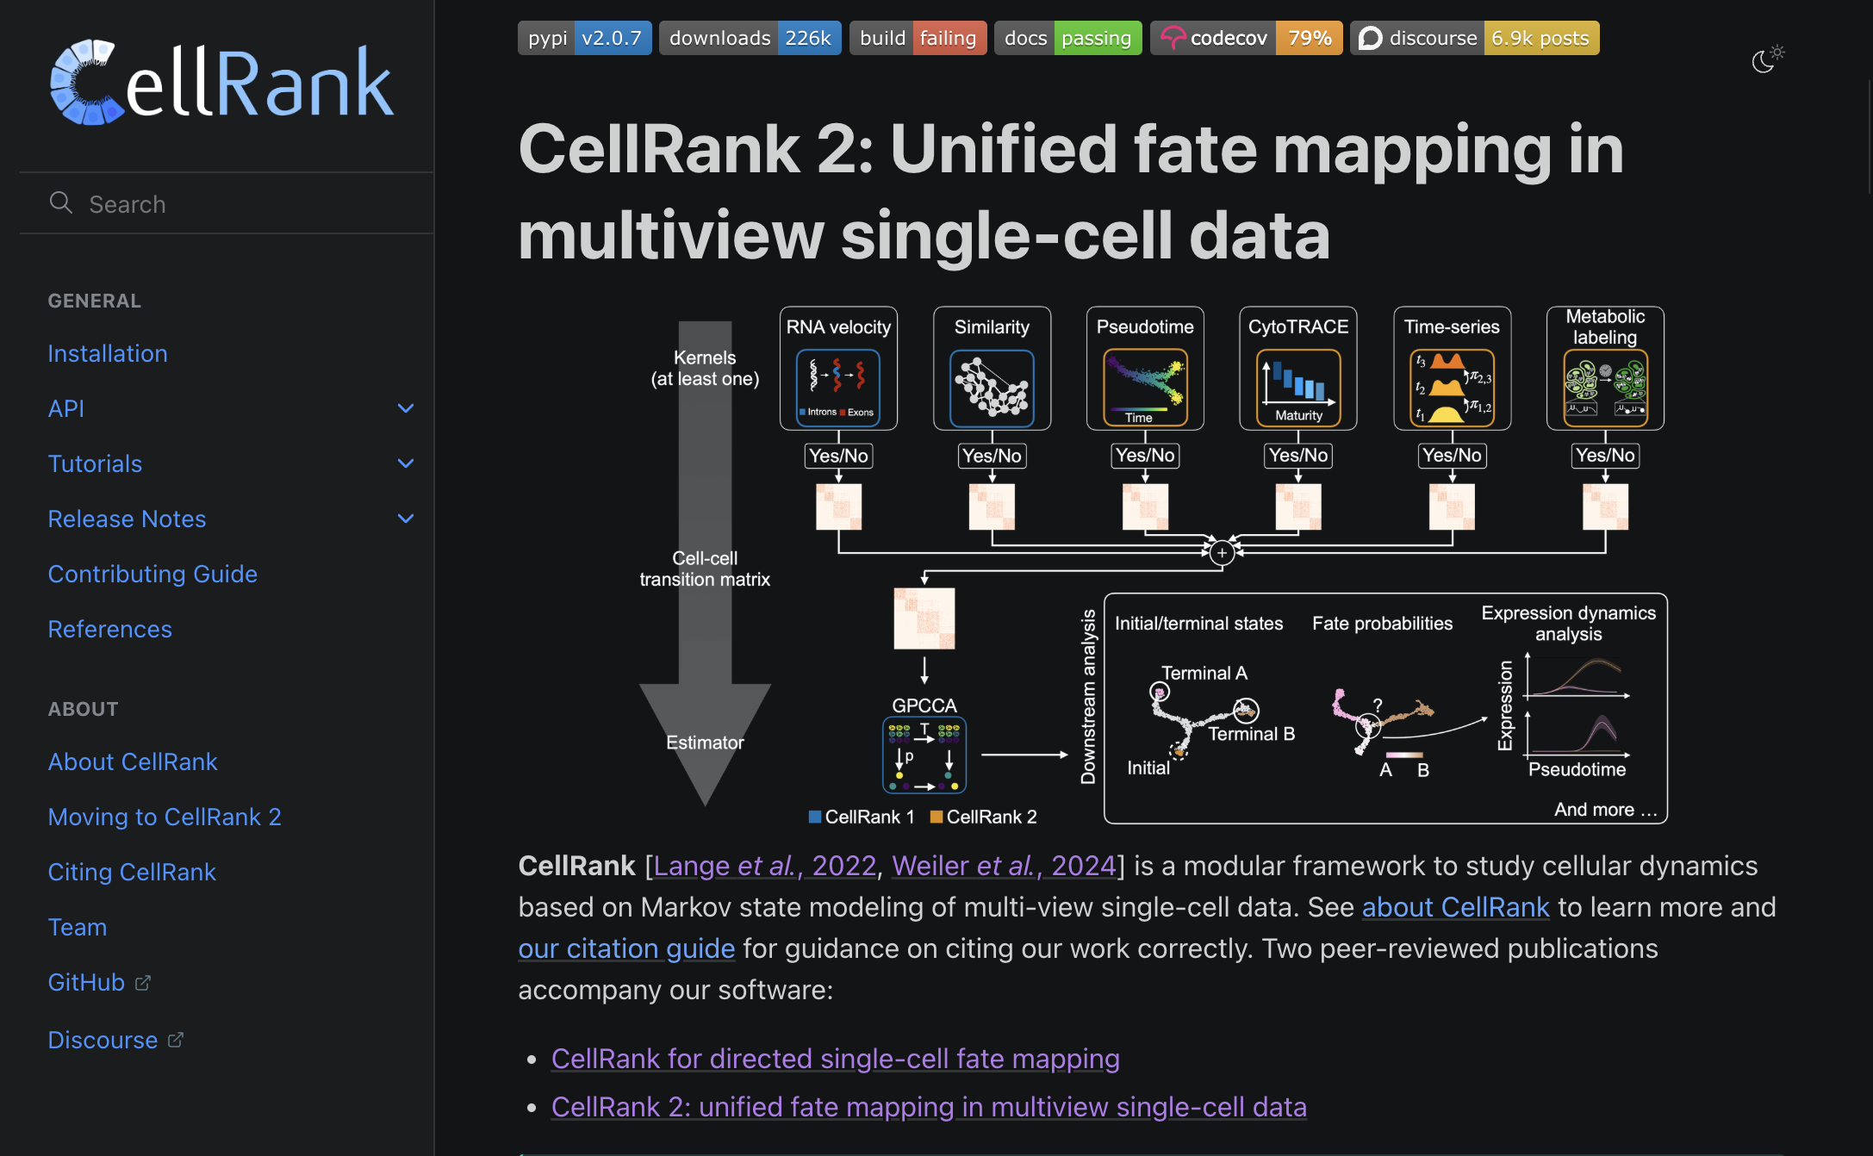

combined cell-cell similarity with RNA velocity
Other Kernels Added
https://www.nature.com/articles/s41592-021-01346-6
https://www.nature.com/articles/s41592-024-02303-9
Protocol for Cell Rank2
https://cellrank.readthedocs.io/en/latest/
https://www.nature.com/articles/s41596-025-01314-w

Slide 9

scTalk
Discussion-driven single-cell journal club
Break down key/new papers
Shared standards and critical thinking in analysis
Open questions, interruptions, and debate encouraged
Please Sign-in + Comments & Questions

Slide 10
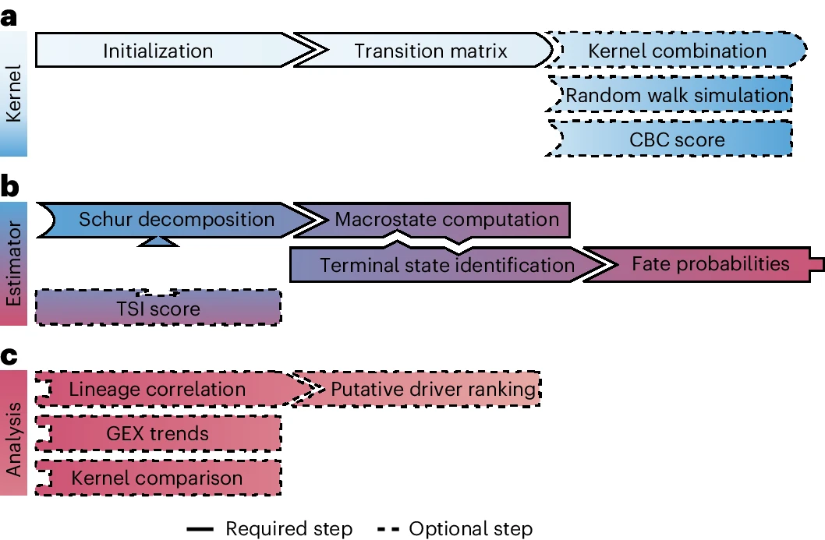
Fig. 1: CellRank is a modular and scalable framework for cellular fate mapping.

Slide 11
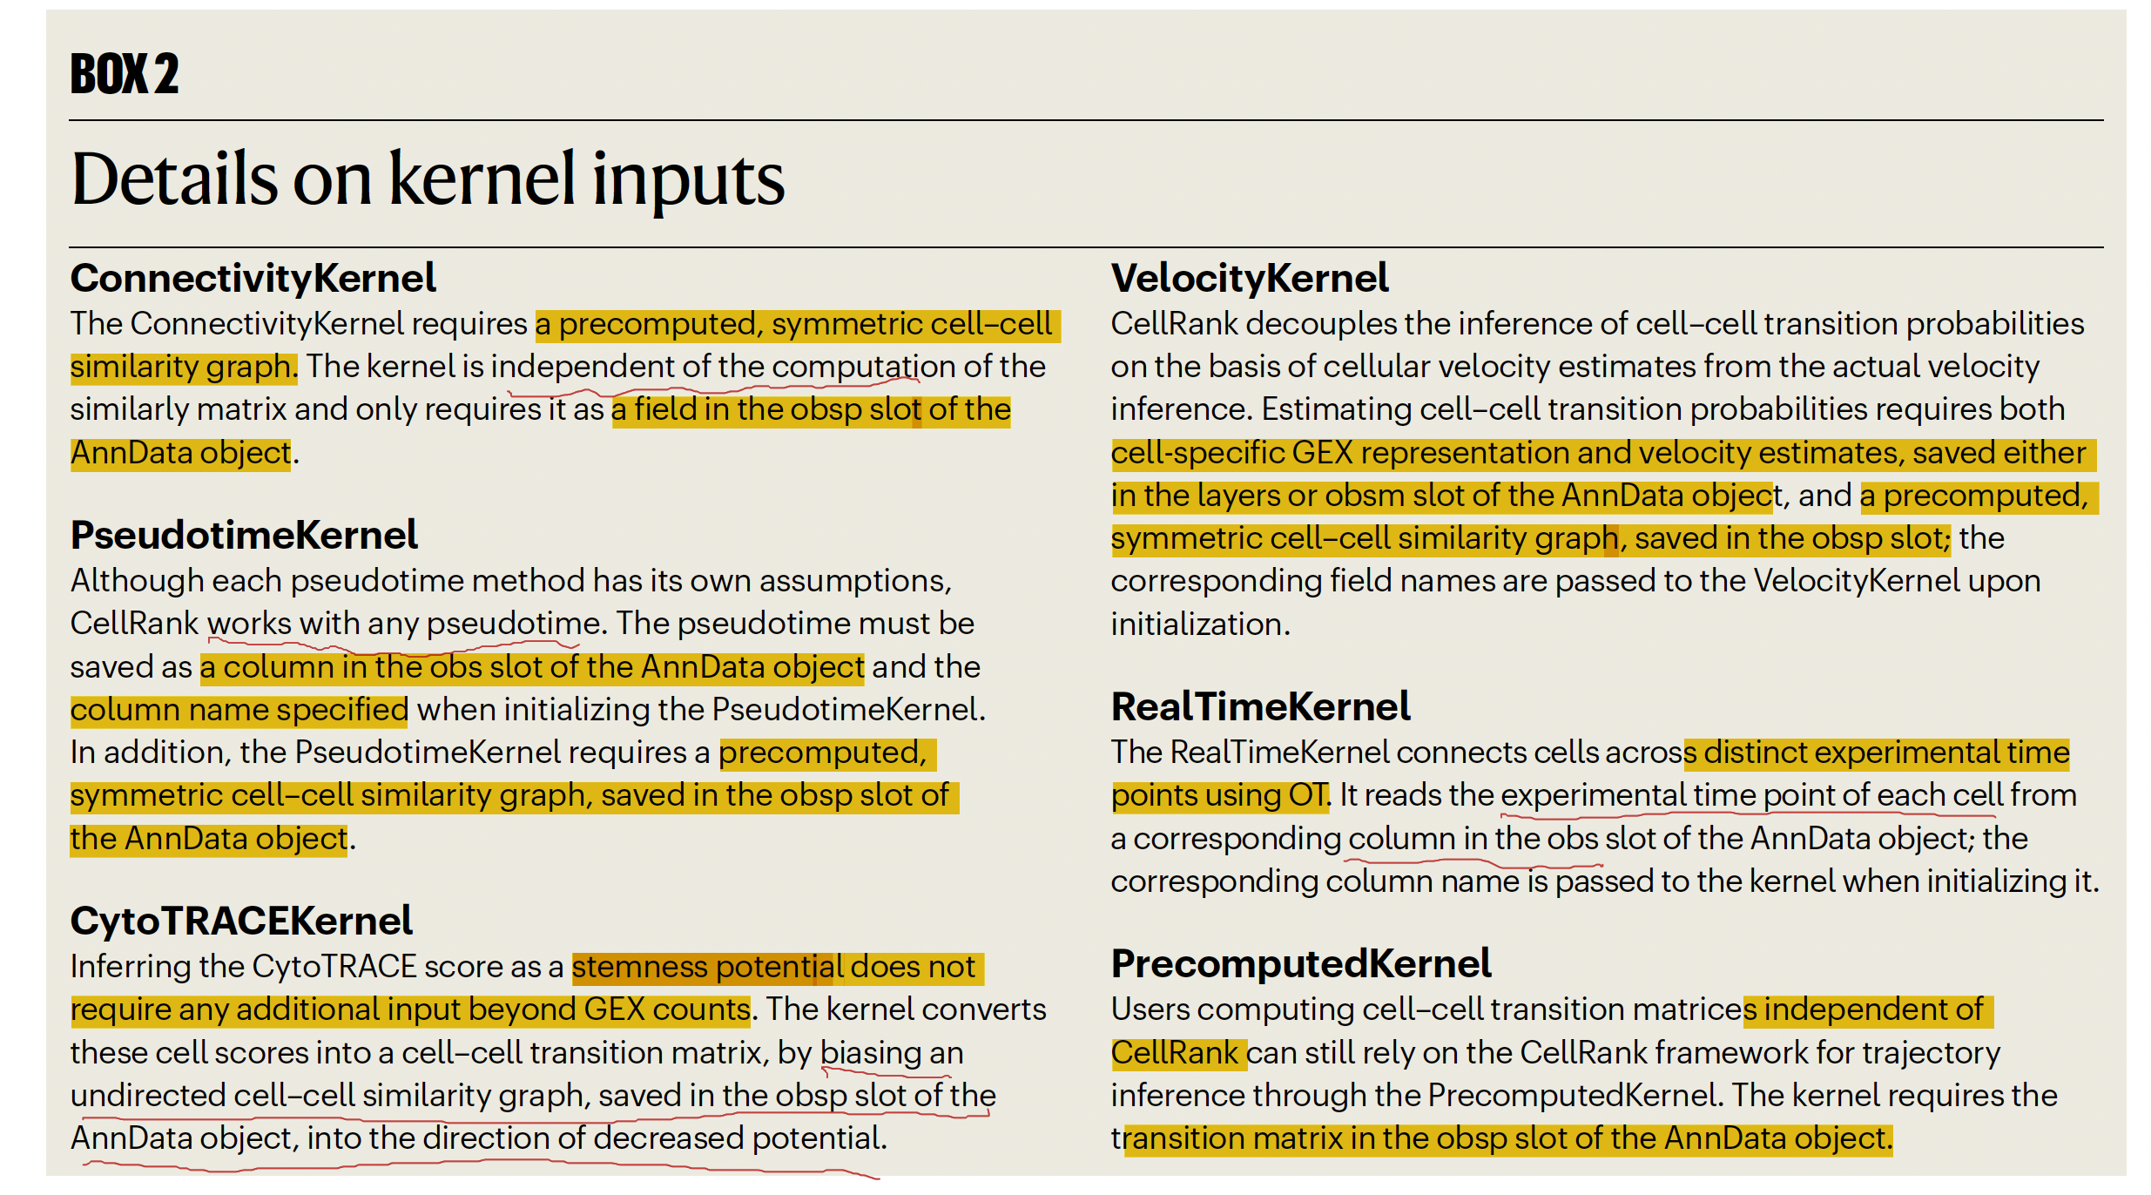

Slide 12
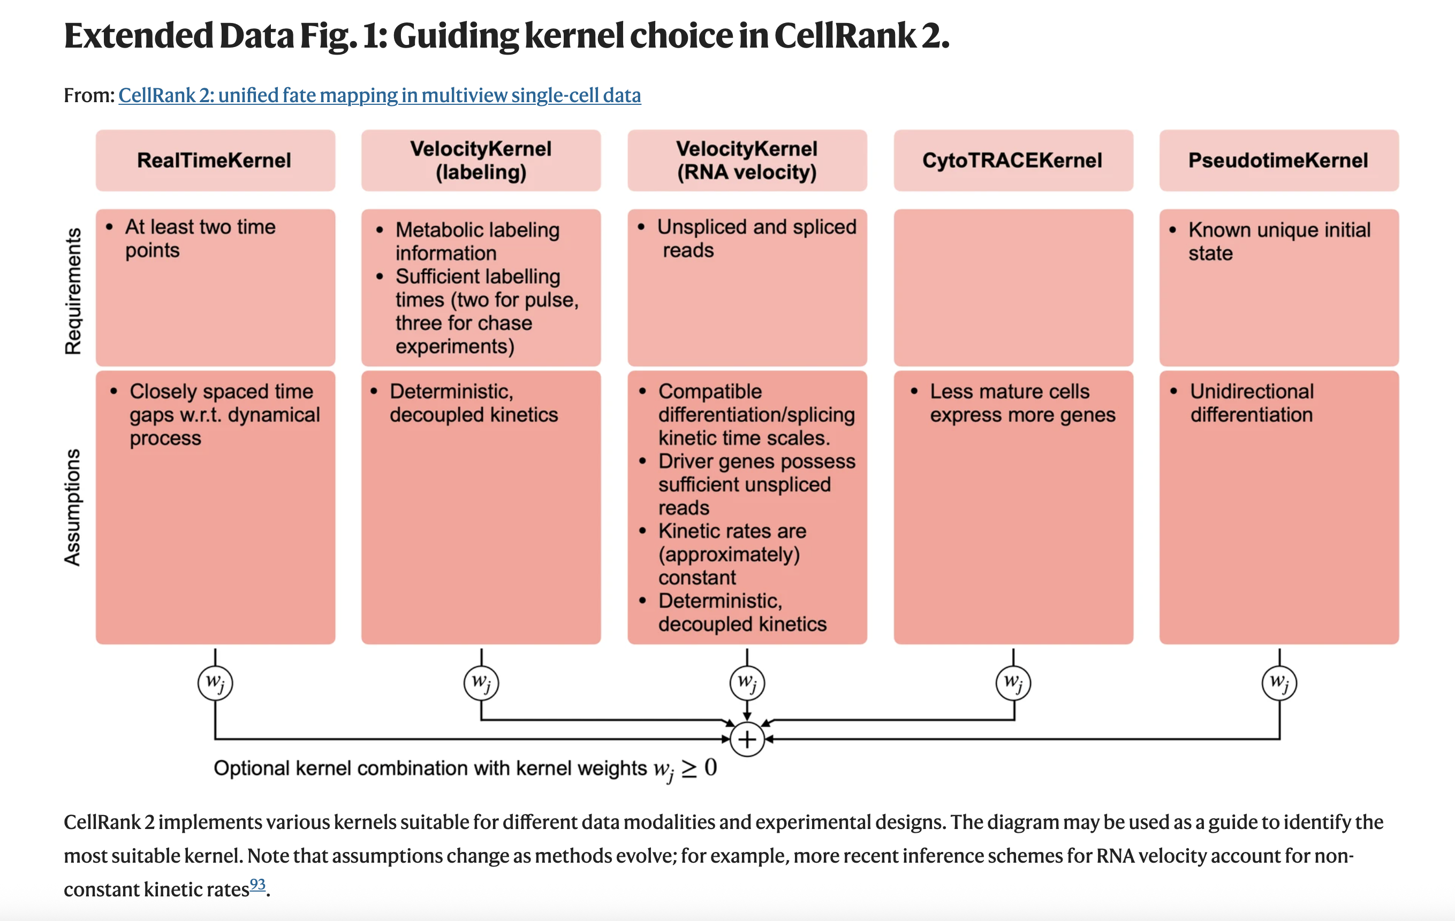
Decision Tree for Choosing Kernels

Slide 13
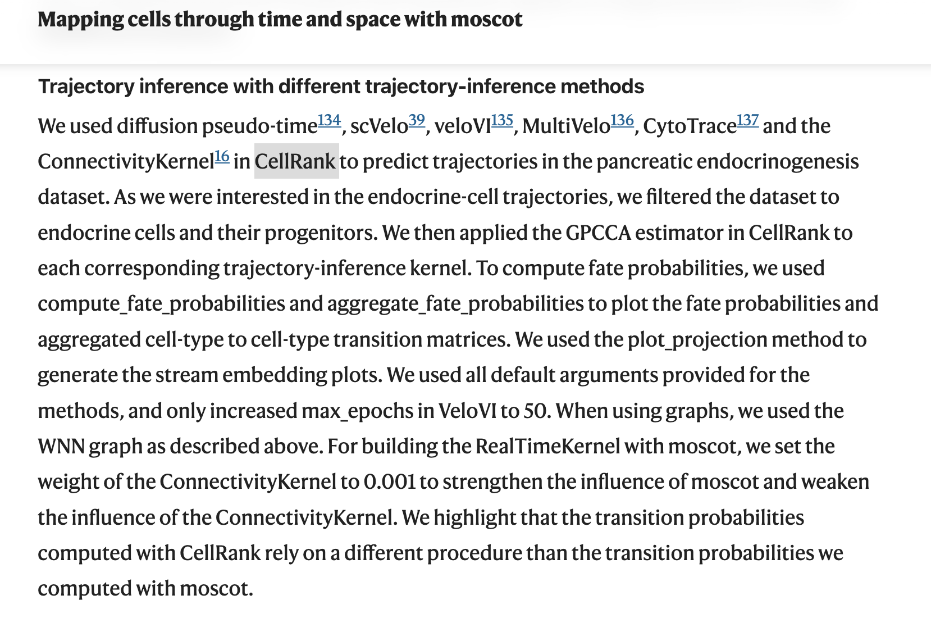
CellRank Kernels have also been used in the Moscot paper
https://www.nature.com/articles/s41586-024-08453-2#Sec8

Slide 14
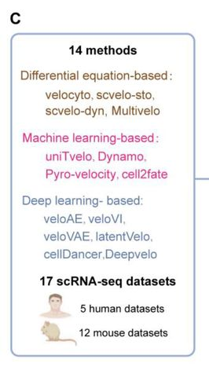
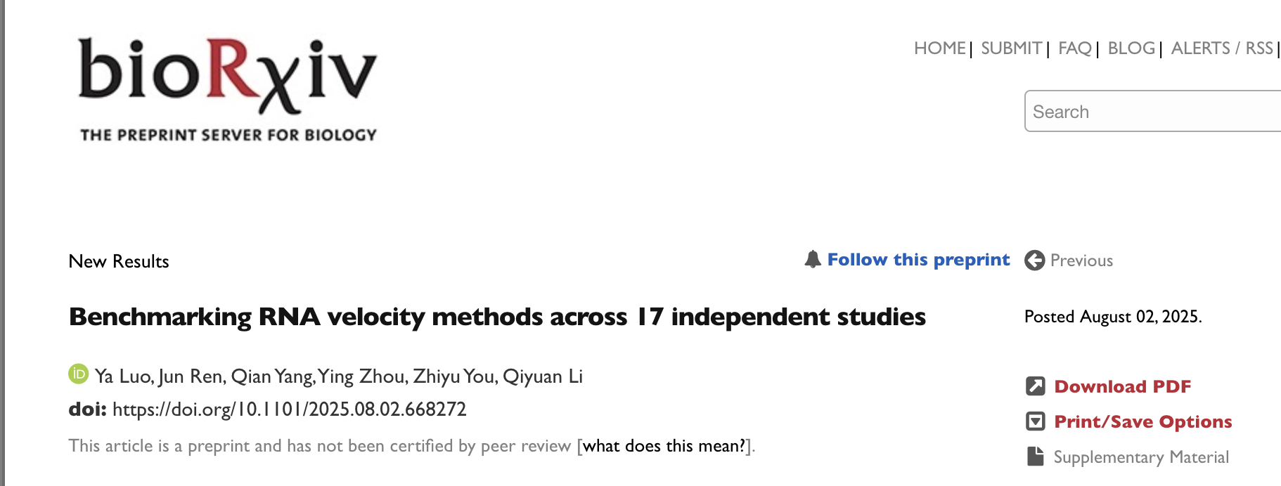
Different Velocity Methods
https://www.biorxiv.org/content/10.1101/2025.08.02.668272v1

Slide 15
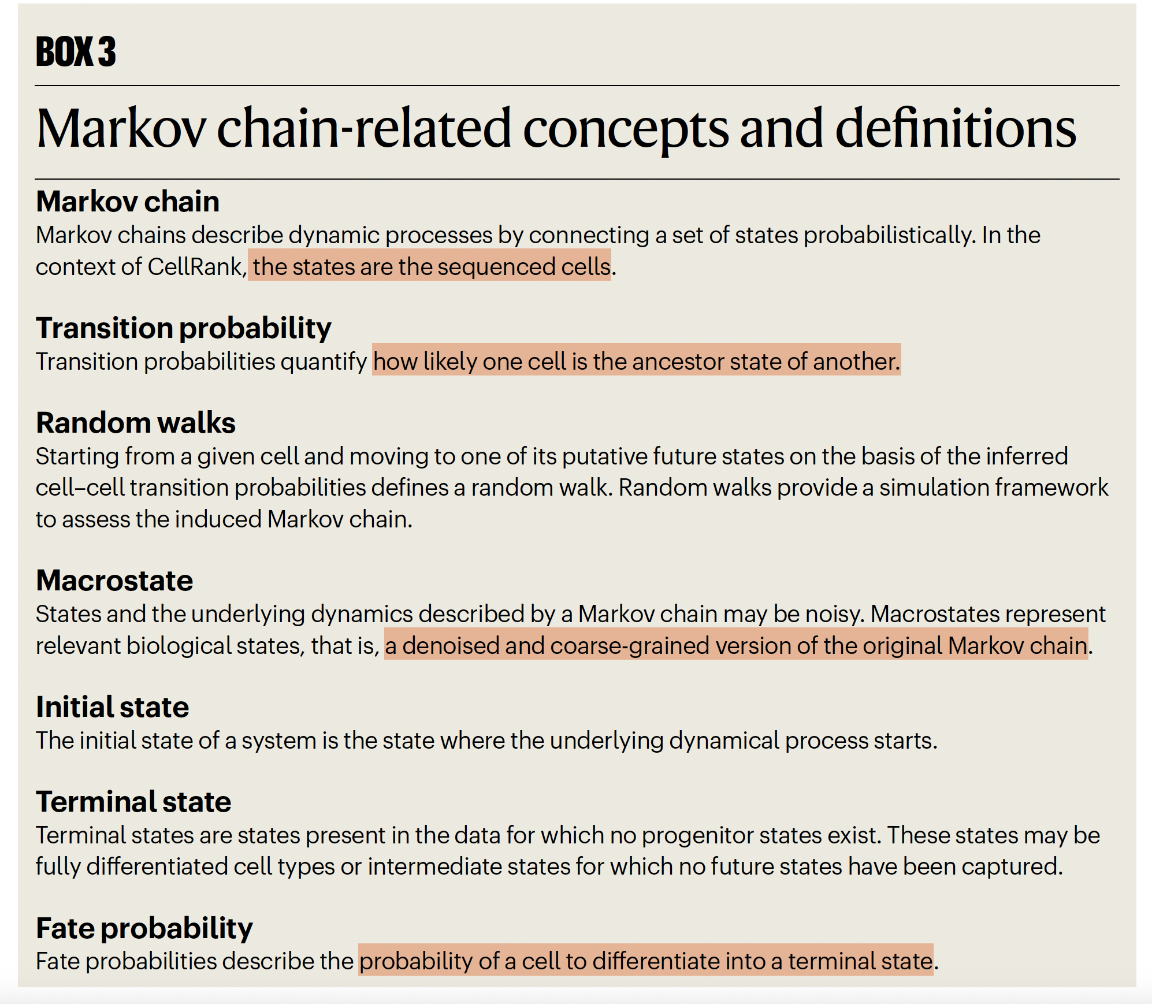
CellRank models average cellular behavior, assuming incremental, memoryless change along the phenotypic manifold.
CellRank collects the cell-cell transition probabilities in a cell-cell transition matrix that defines/induces a Markov chain and for each matrix an estimator analyzes the induced Markov chain to infer the initial and terminal states of a biological process, quantify the corresponding fate probabilities, describe their lineage formation and enable further downstream analyses.
Generalized Perron cluster cluster analysis (GPCCA) estimator coarse grains the transition matrix to define macro states and transition probabilities between them, thereby defining terminal states and fate probabilities.

Slide 16
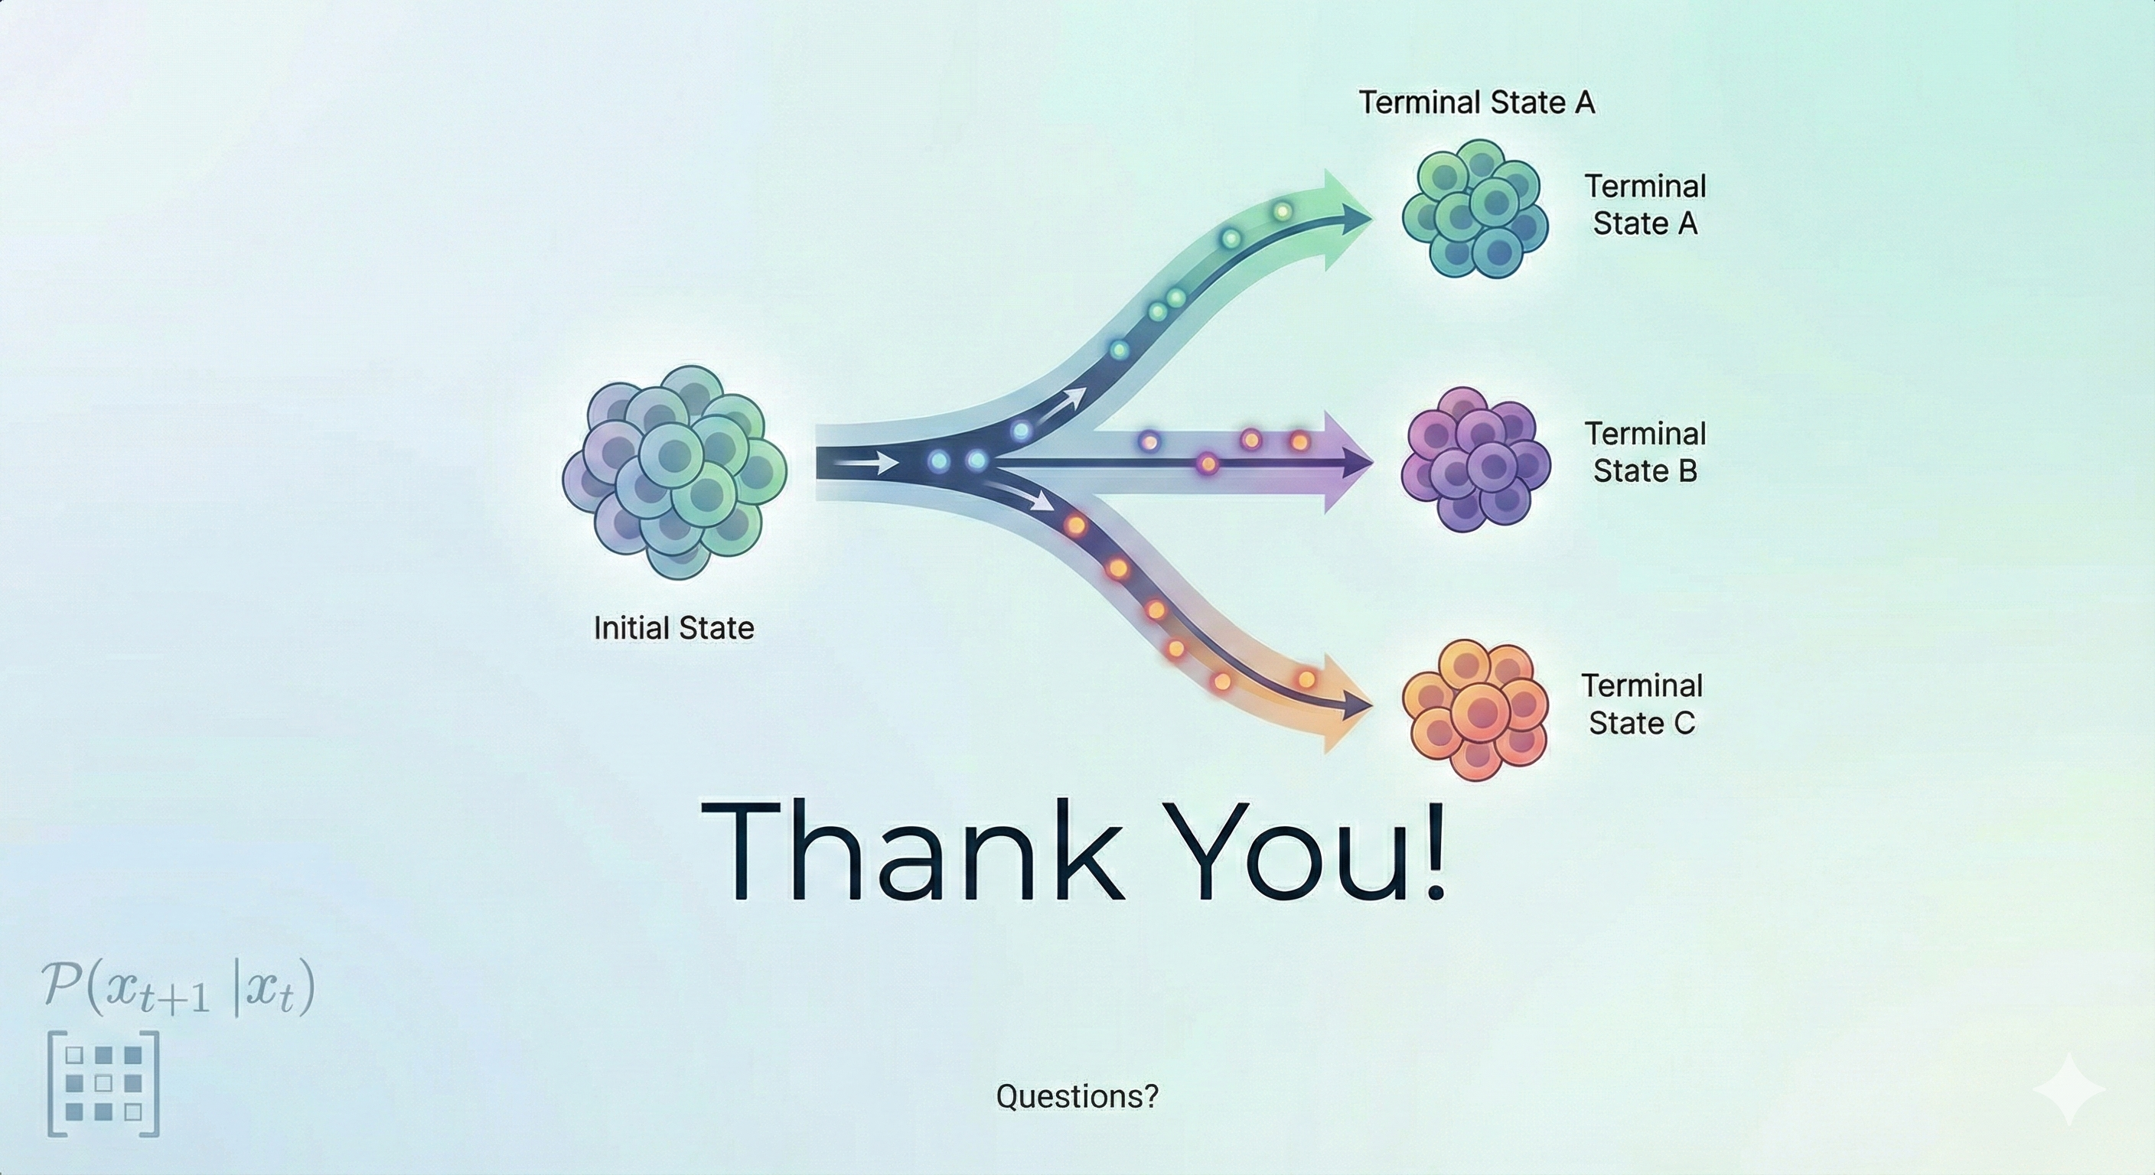

Slide 17
Supp Slides

Slide 18
Single Cell 101

Slide 19

The Body as a Country!
Body = USA
Organs = States with specialized roles (Brain, Heart, Lungs, etc.)
Tissues = Cities (Cardiac muscle, Alveolar tissue, etc.)
Niche = Neighborhoods
Cells = Buildings / Organizations / Companies

Slide 20
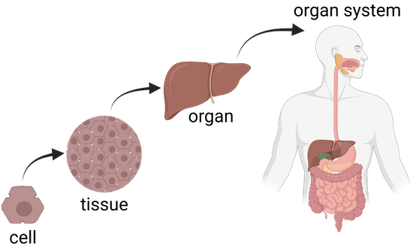
Cells coordinate to keep each “city” functioning!
A cell is the basic membrane-bound unit that contains the fundamental molecules of life and of which all living things are composed.
A single cell is often a complete organism in itself.
https://www.britannica.com/science/cell-biology
https://www.khanacademy.org/

Slide 21
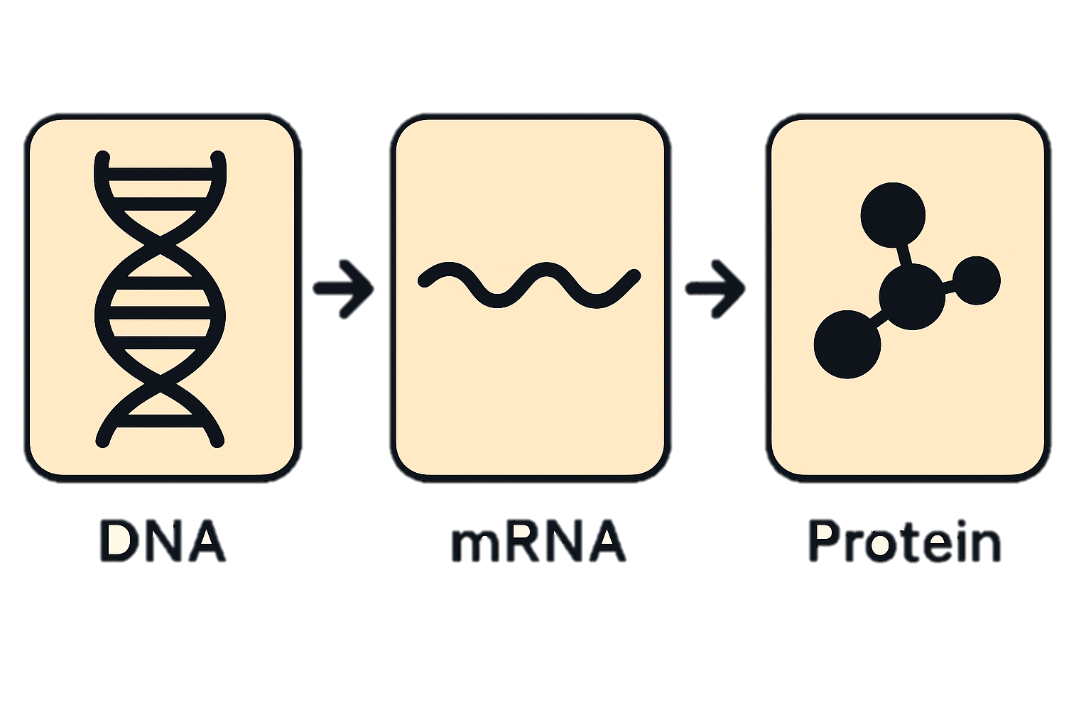

Every cell = a self-run organization inside the city
DNA = full archive of laws and manuals
Genes = individual regulations
mRNA = copied memos for active tasks
Proteins = workers, machines, and tools
Signals = inter-building communication

Slide 22
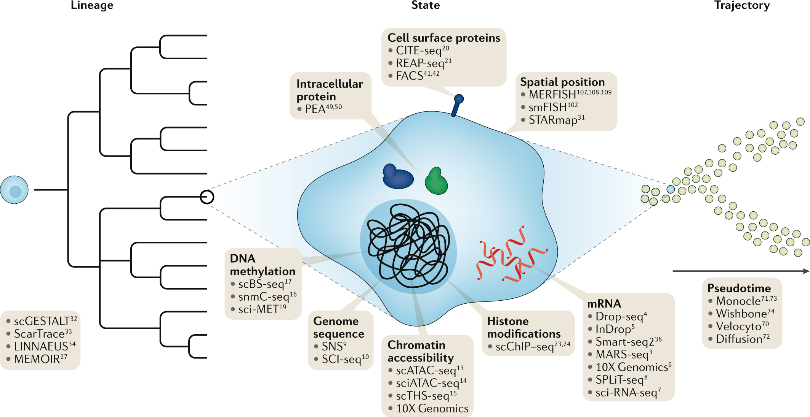
Proteomics = Workers, Machines, and Tools Operating in the Company
Metabolomics = Fuel, Supplies, Raw Materials, Waste
Genomics = The Full Law Book + Master Manuals
Transcriptomics (RNA-seq) = Memos Being Copied & Circulated
Epigenomics = Access Control + Bookmarks + Locked Archives
Stuart and Satija. Nature Reviews Genetics. 20:257-272. May 2019

Slide 23
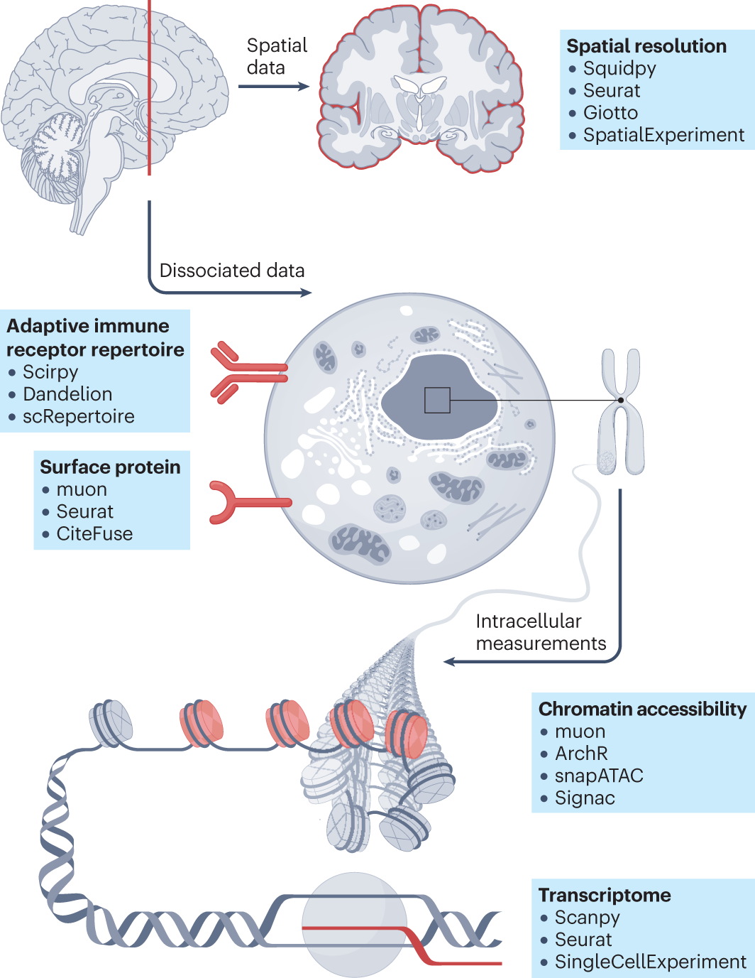





Fig1. Single-cell analysis across modalities
in
in
( )

Slide 24
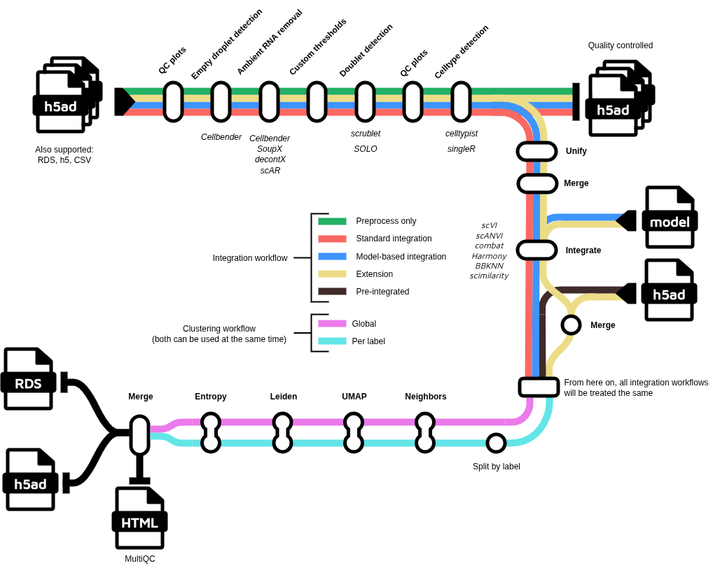
nf-core/scdownstream
https://nf-co.re/scdownstream/dev/

Slide 25
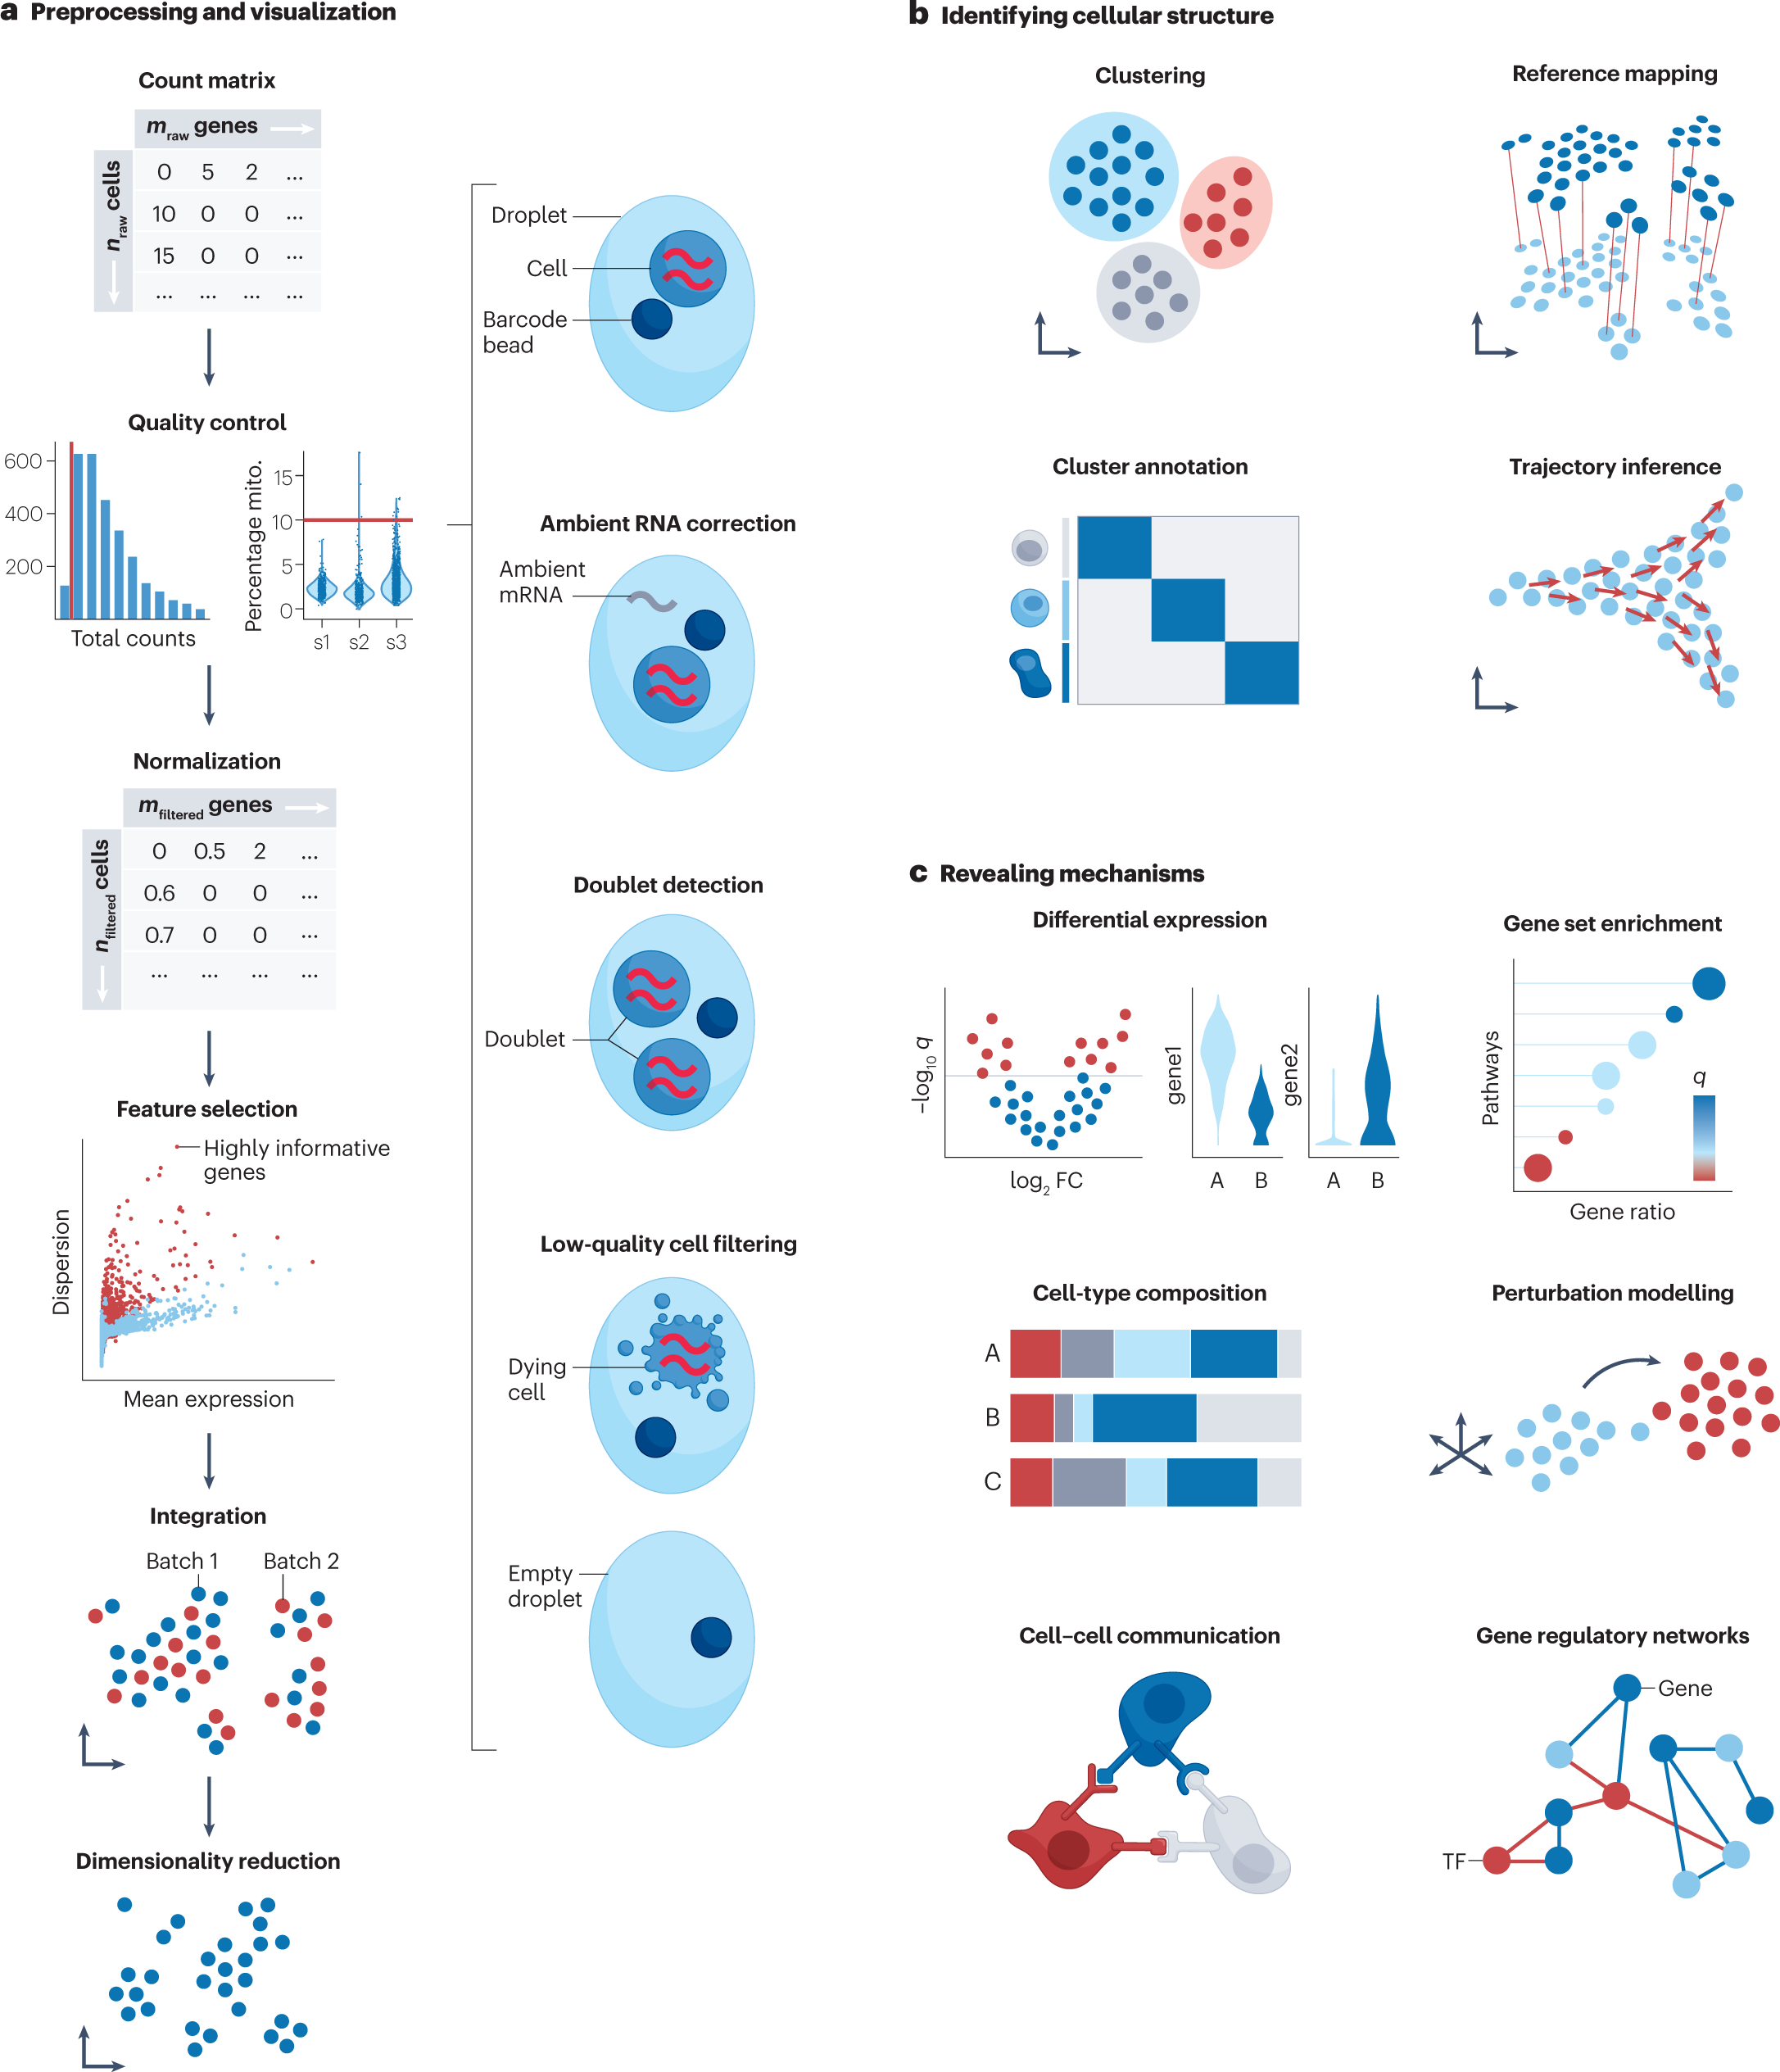
Fig2. Overview of unimodal analysis steps for scRNA-seq

Slide 26
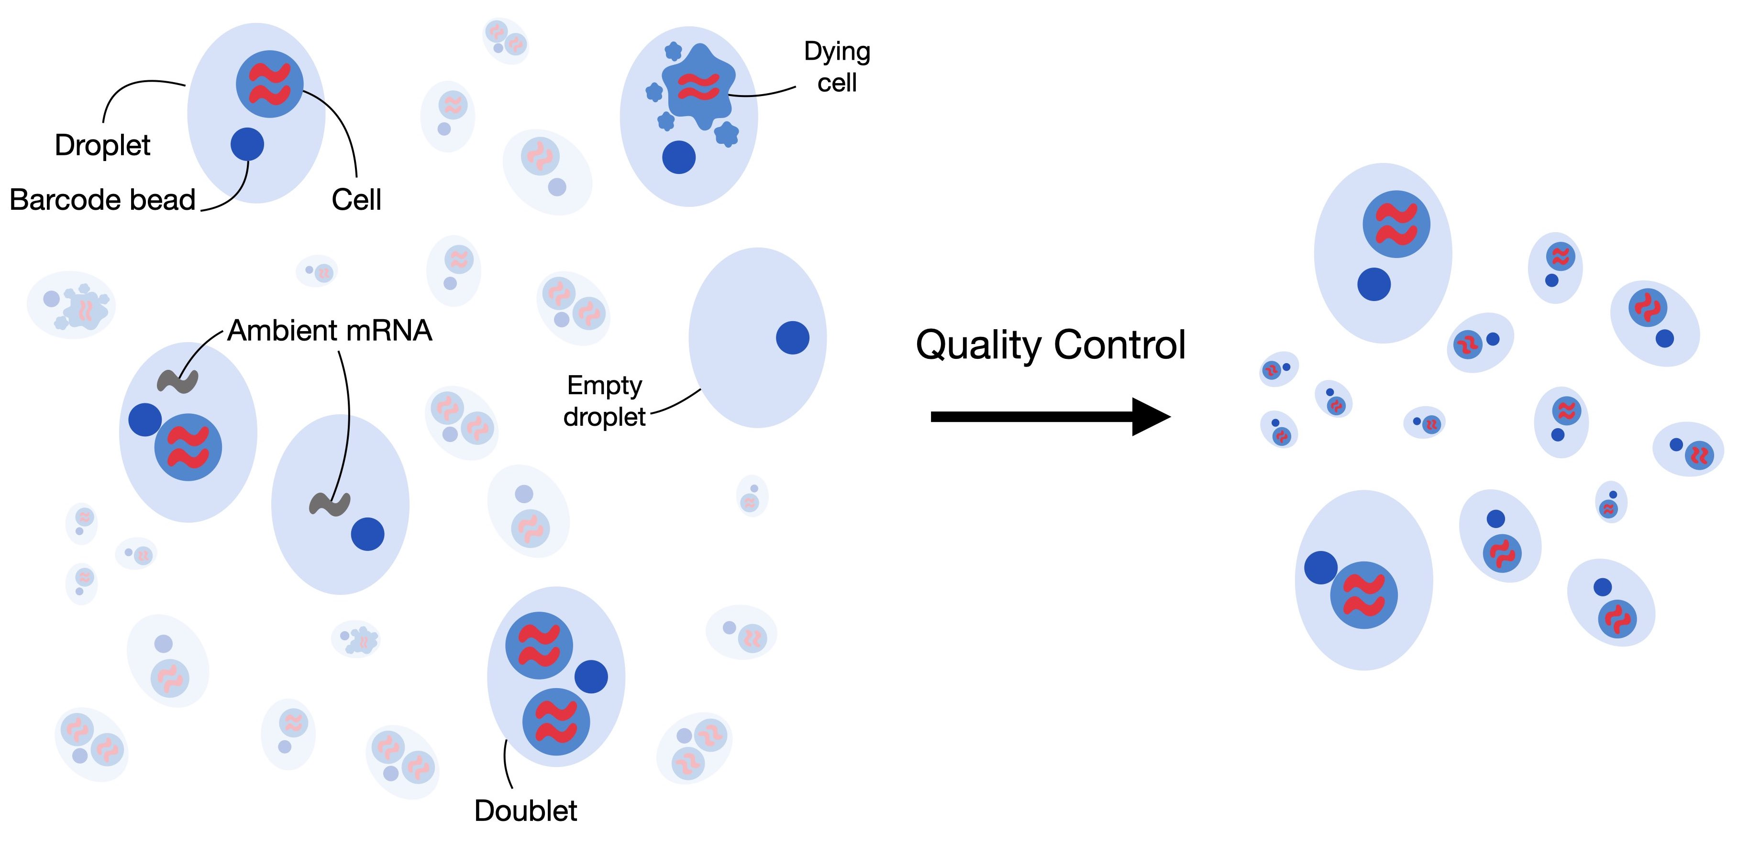
Fig. 6.1 low-quality cells, cell-free RNA and doublets (Book)

Slide 27
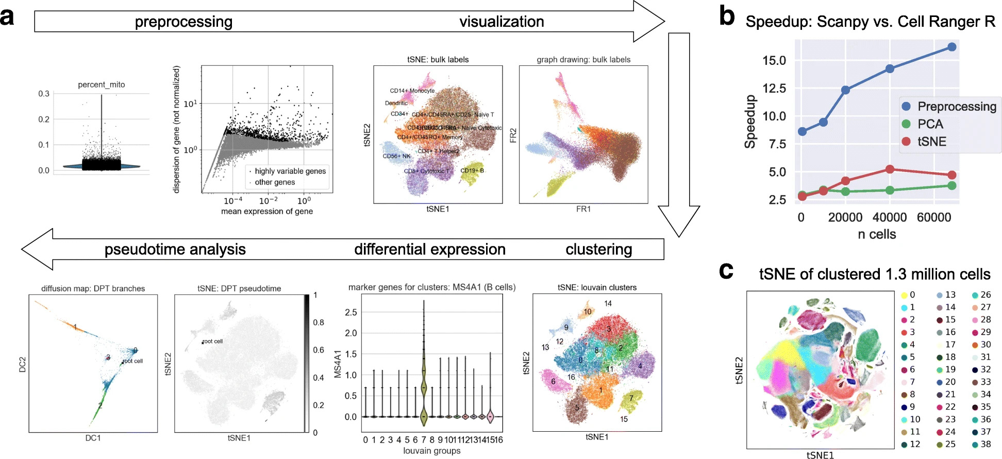
Fig. 4.2 scanpy overview (Book)

Slide 28
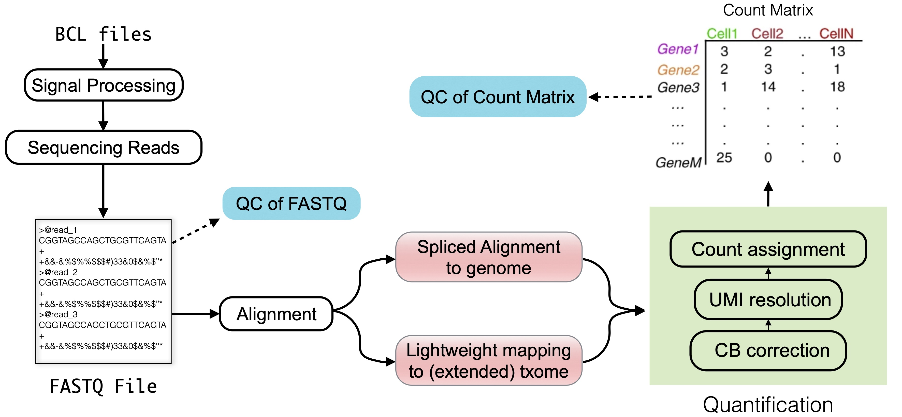
Fig. 3.1 (Book)
“txome” stands for transcriptome

Slide 29
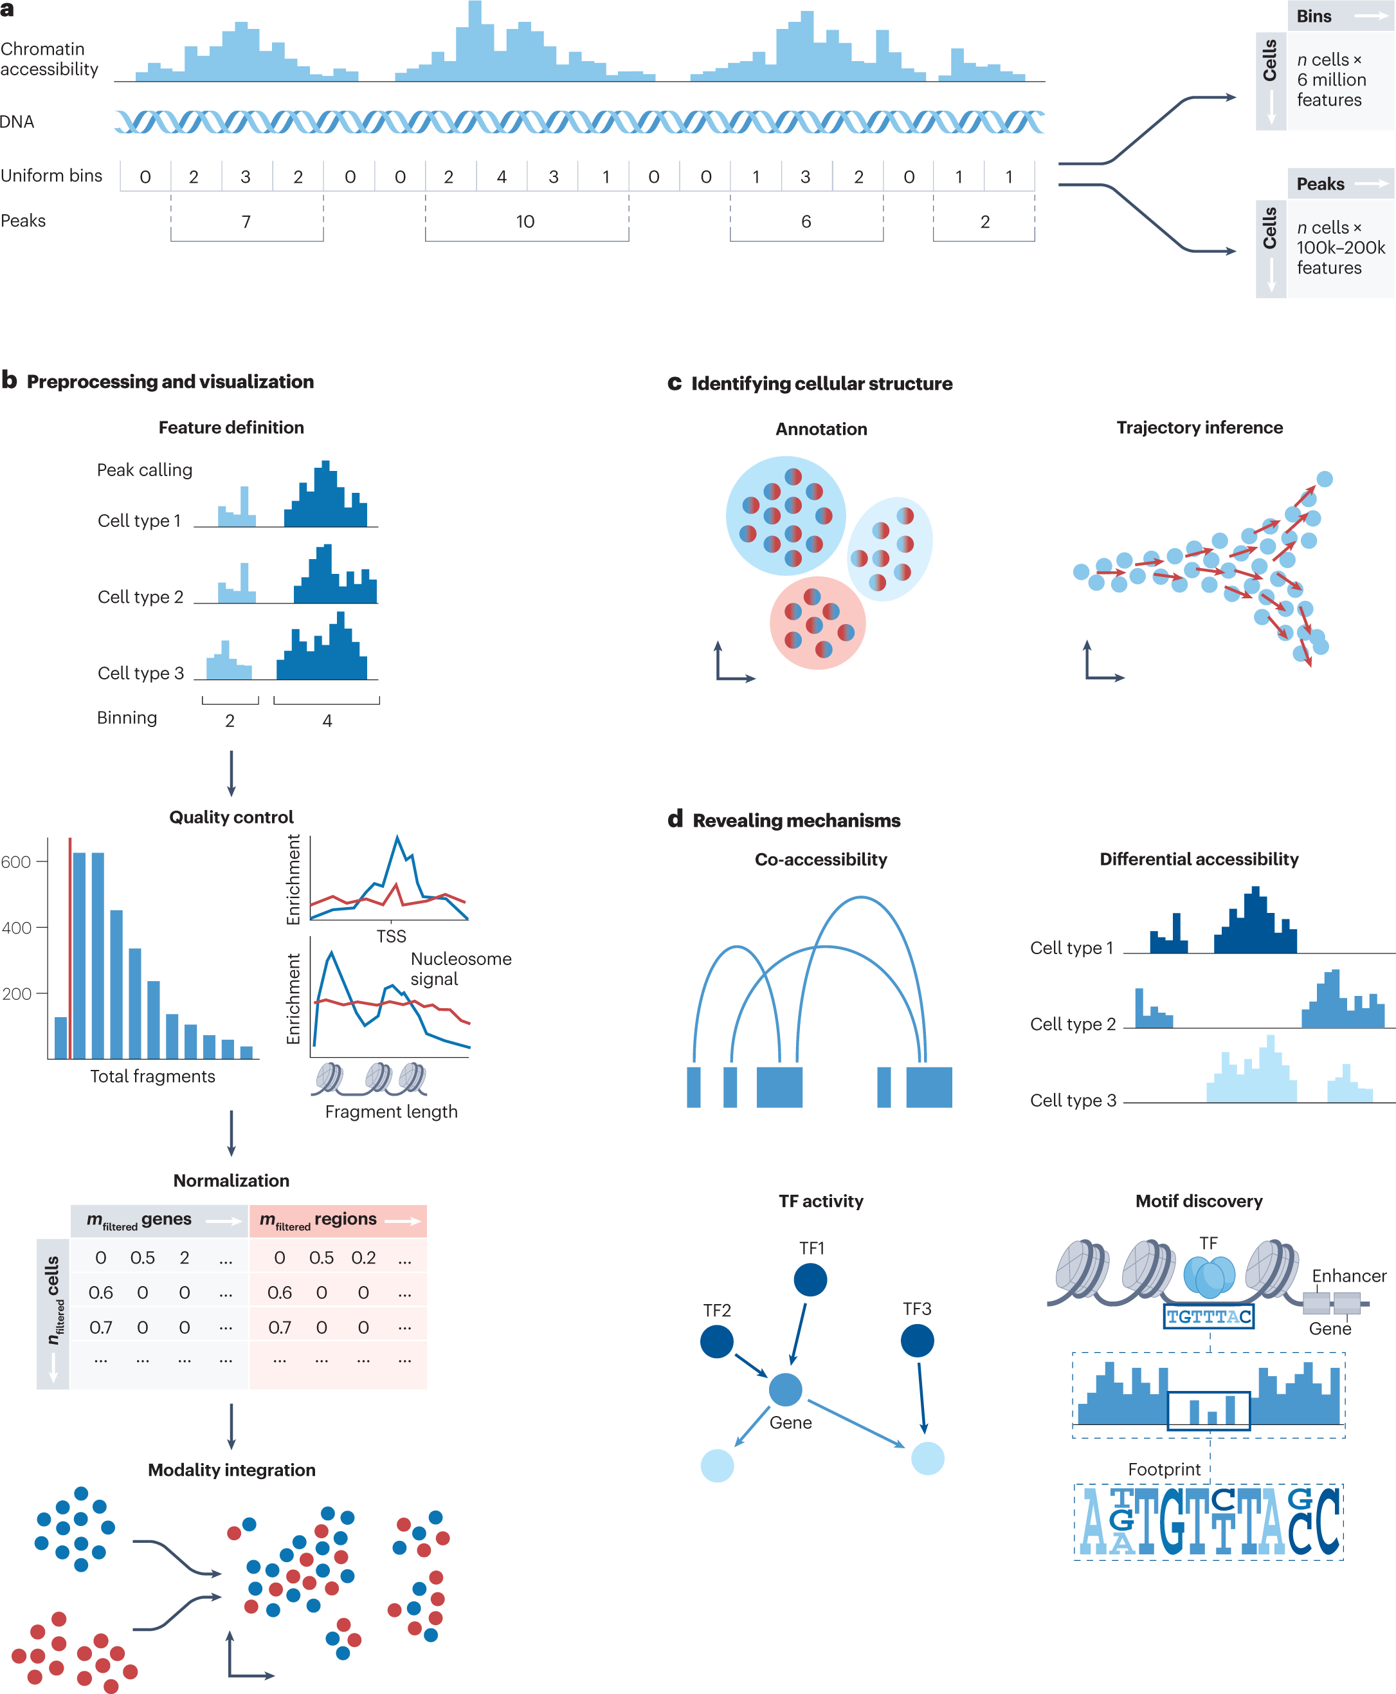
Fig. 3: Overview of scATAC-seq analysis steps

Slide 30
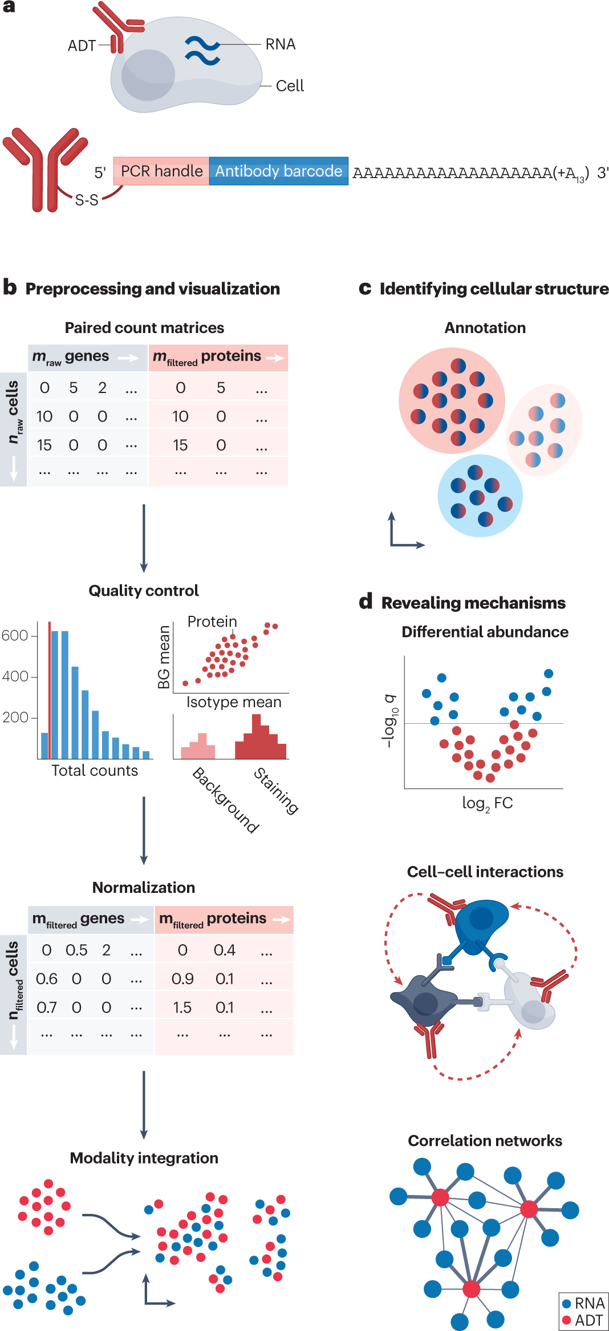
Fig. 4: Overview of CITE-seq data processing

Slide 31
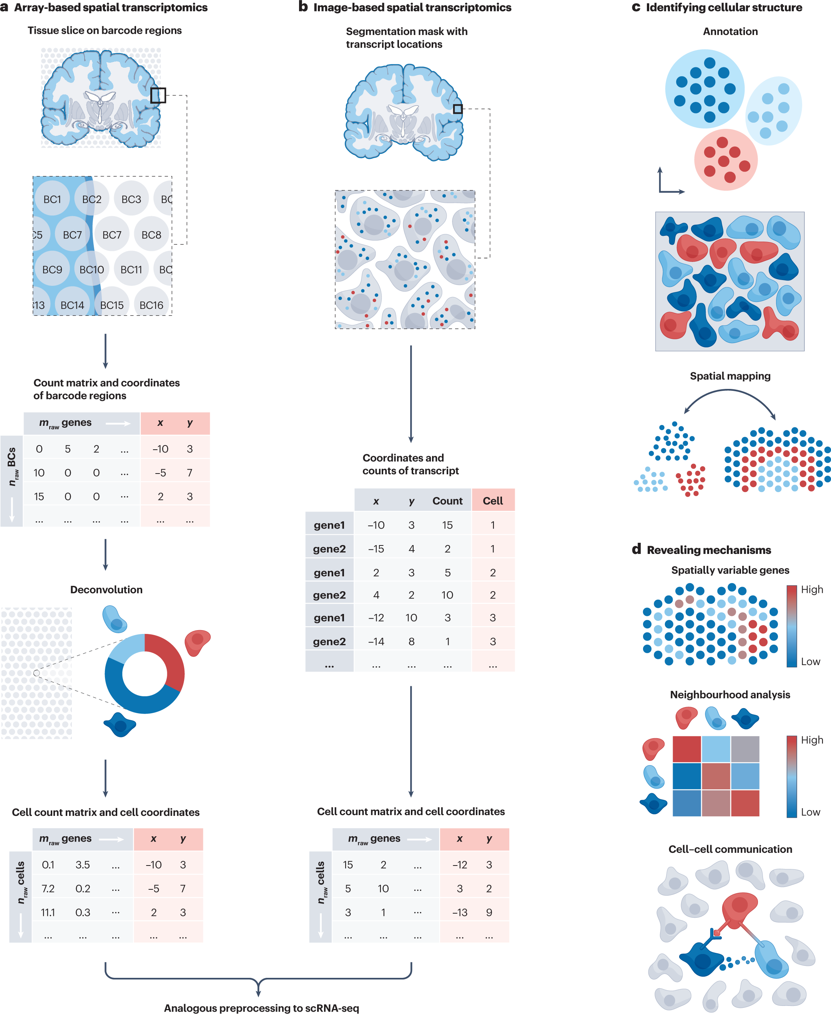
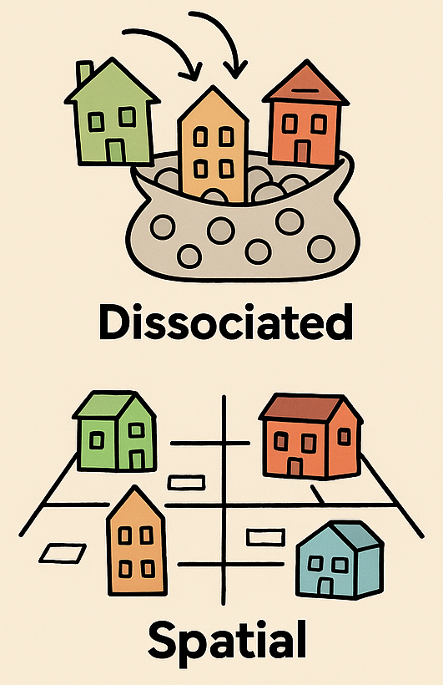
Fig. 6: Overview of spatial transcriptomics preprocessing and downstream analysis steps
Dissociated vs. Spatial Single-Cell

Slide 32
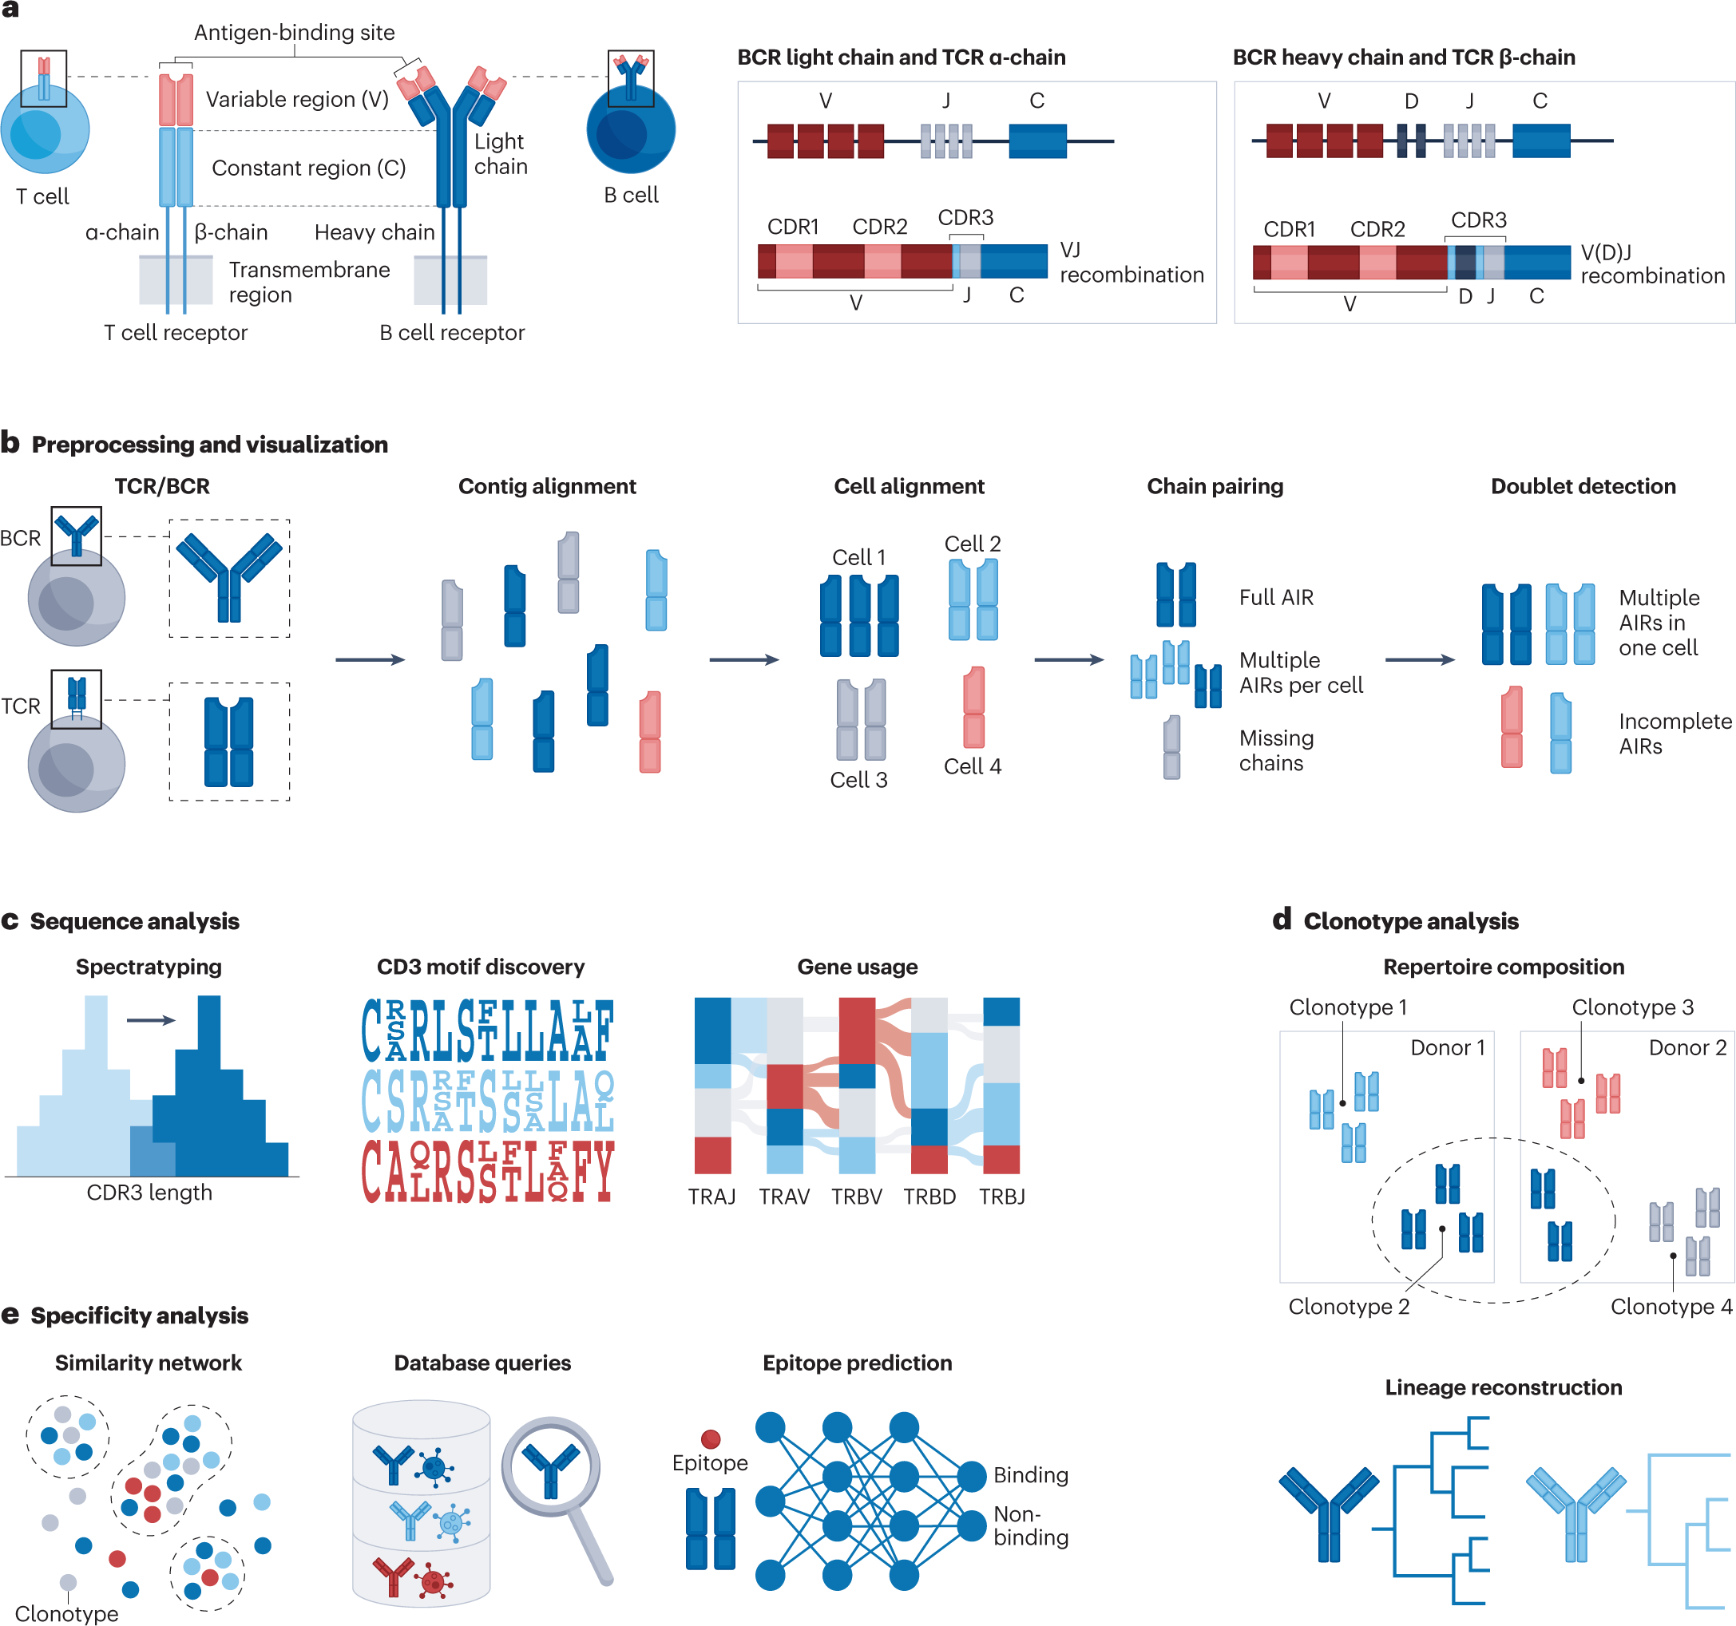
Fig. 5: Overview of the adaptive immune receptor analysis

Slide 33
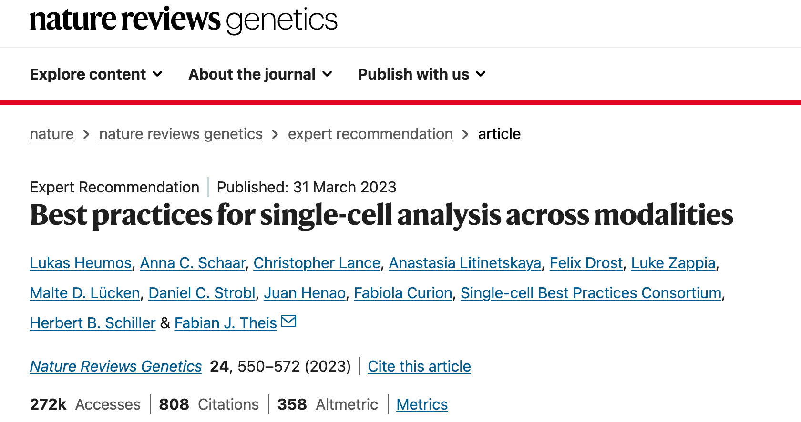
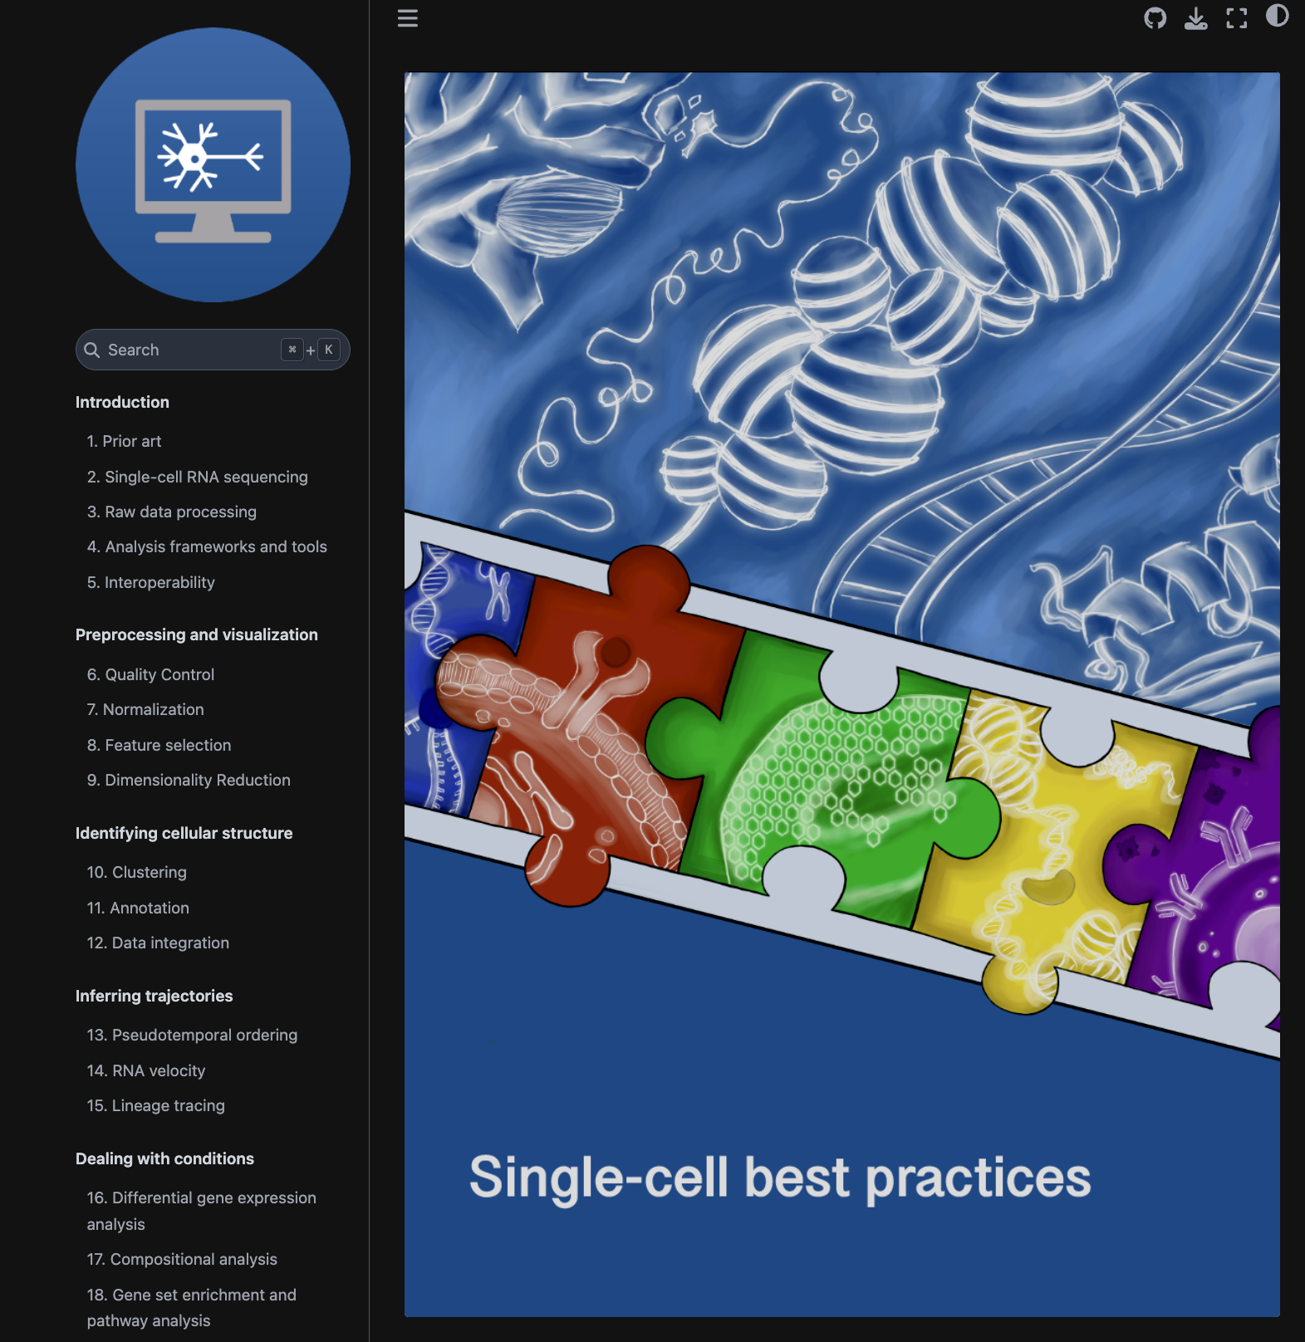
scTalk1
https://www.nature.com/articles/s41576-023-00586-w

Slide 34
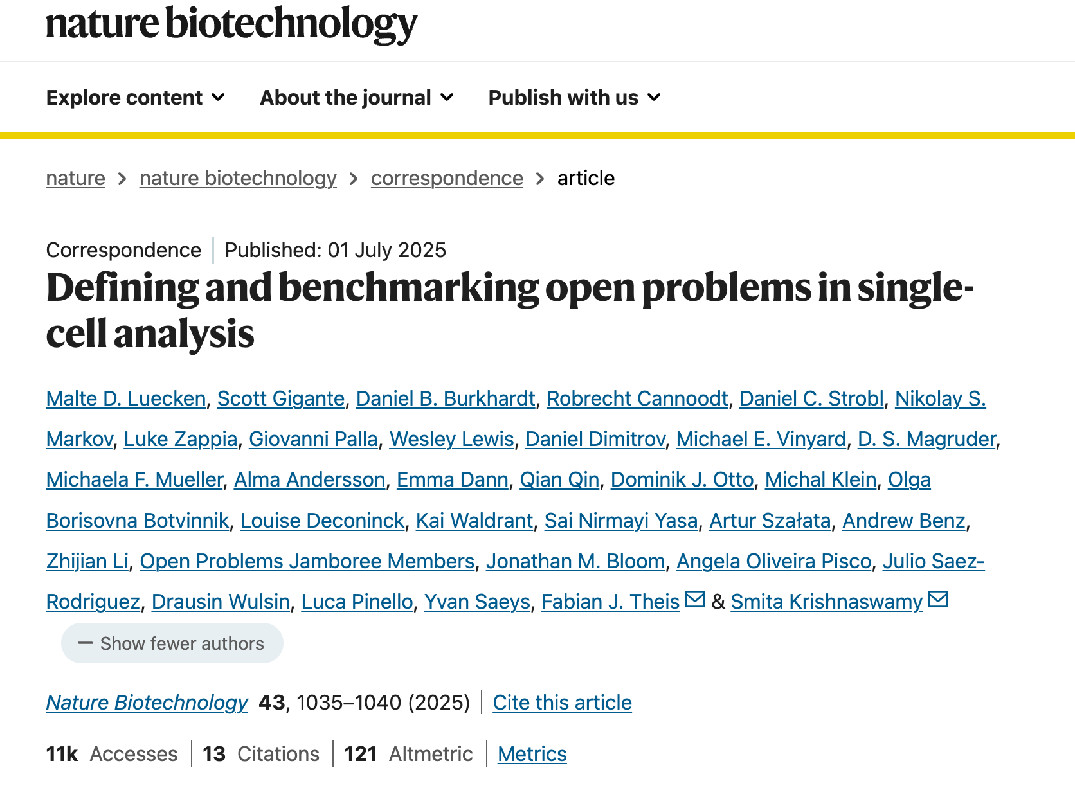
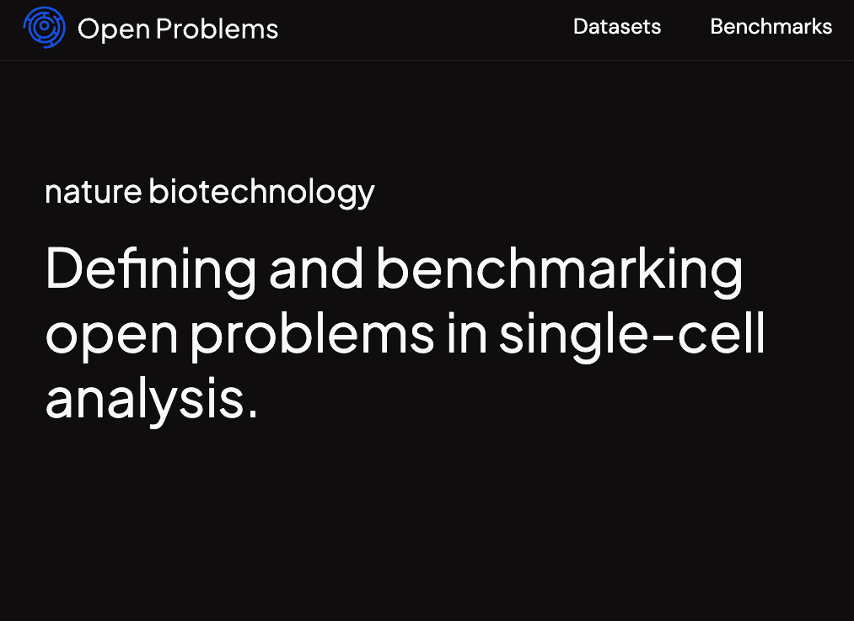
openproblems.bio
Helmholtz Munich & Yale

Slide 35
Why we need uniform, live, independent, and standardized benchmarks?
Bespoke benchmarks set up by method developers to evaluate newly developed algorithms often include datasets and metrics chosen to highlight the advantages of their tools, which has been shown to lead to less objective assessments^{6,7}. Even if datasets and metrics are standardized, historical analysis shows that when benchmarks are implemented by the same groups introducing new methods, the evaluations tend to inflate performance of the newest models via custom hyperparameter selection and data processing⁸.
… efforts aim to systematically evaluate the current state of the art in a given area and may be less biased. However, their results are static and inevitably age.
… datasets and metrics typically have less than 10% overlap between benchmarks¹³.

Slide 36
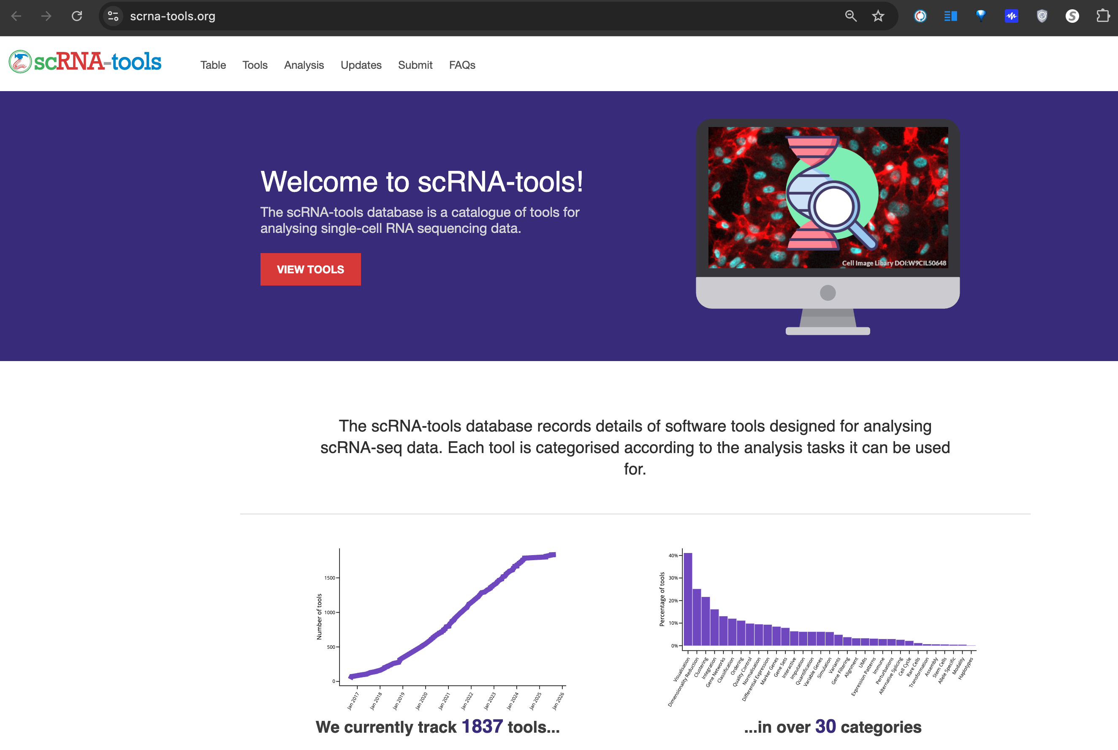
Over 1800 Published Algorithms for single-cell Analysis
https://www.scrna-tools.org

Slide 37
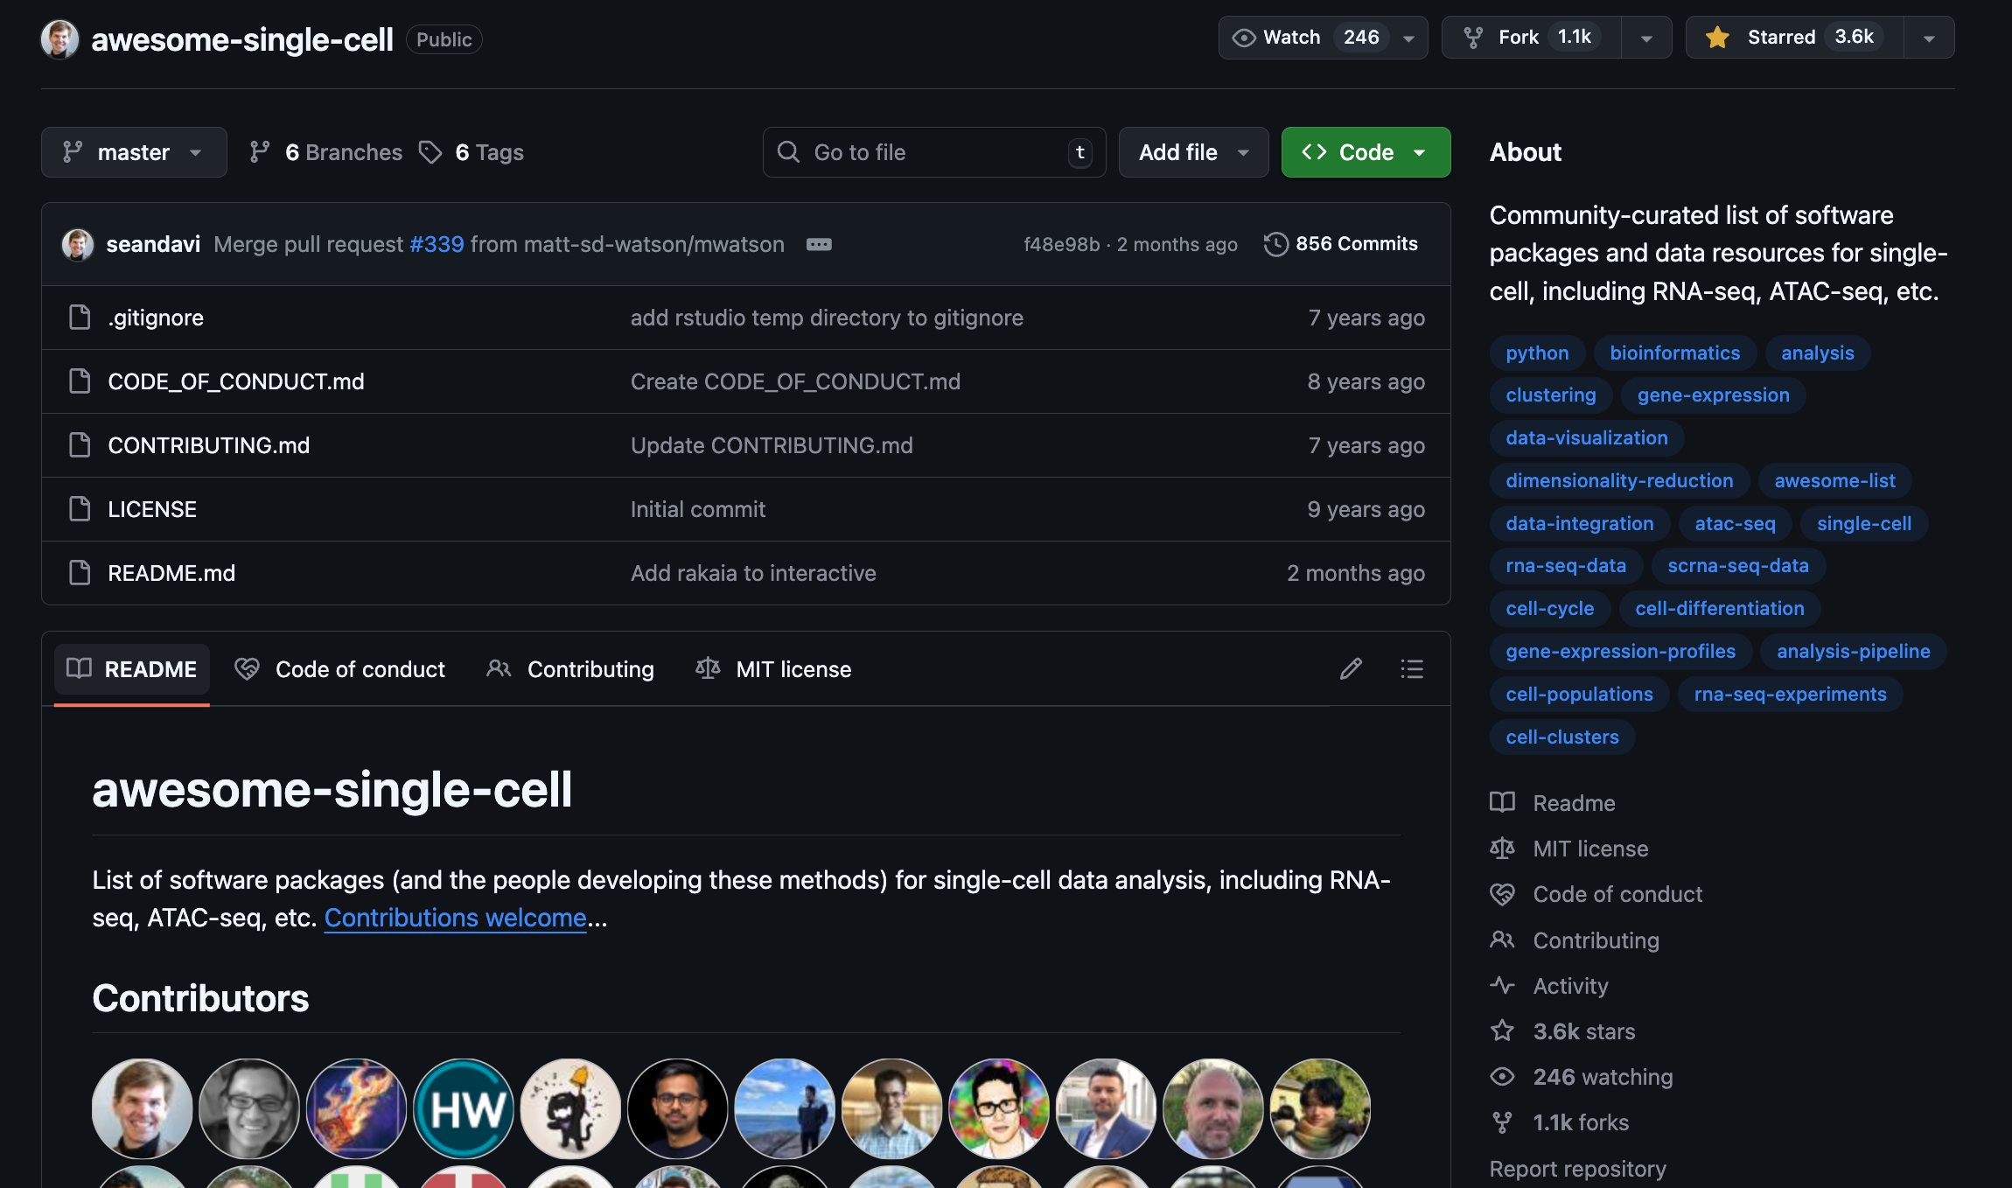
“awesome-single-cell" GitHub collection as a common compilation of single-cell methods
https://github.com/seandavi/awesome-single-cell
https://notebooklm.google.com/notebook/ab5c5e5c-6907-4883-8918-f4868f15ff88

